Slide 1
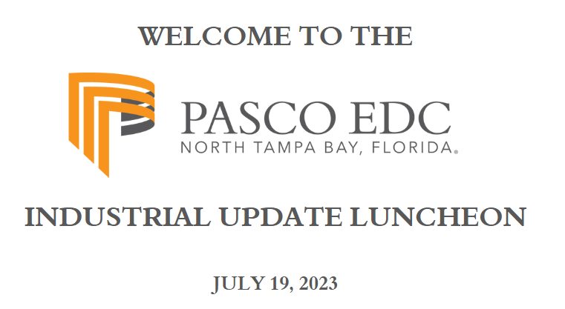

Slide 2
pasco county industrial update
July 19, 2023

Slide 3
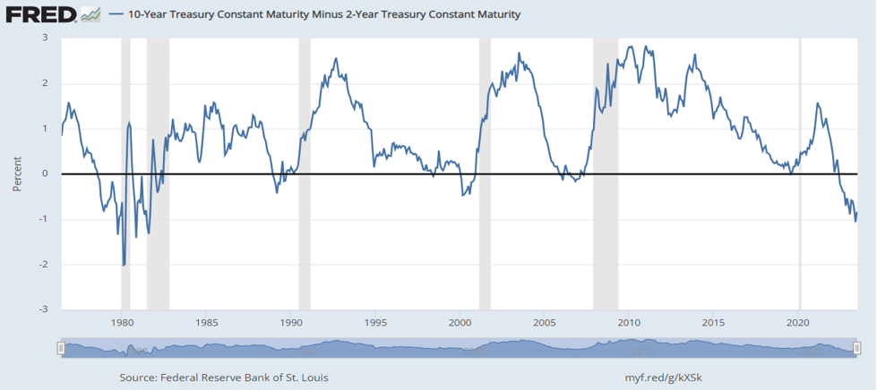
What’s Up (or Down) With the Yield Curve??

Slide 4
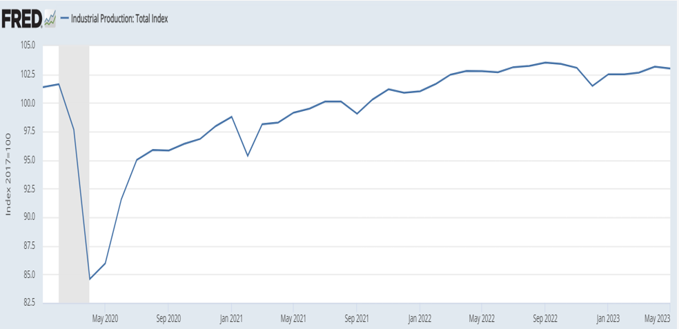
Industrial Production Does Not Yield?

Slide 5
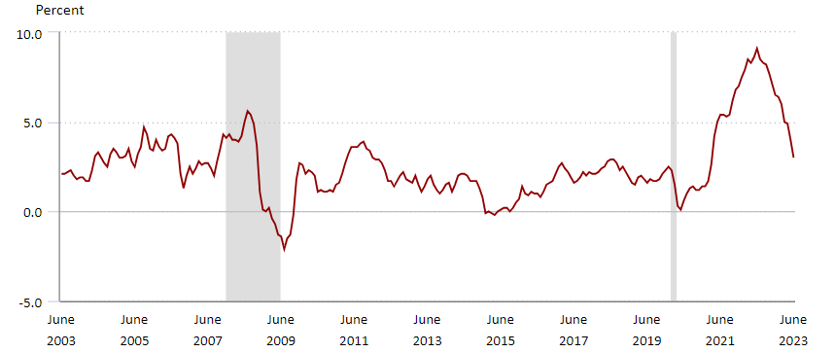
Inflation Has Moderated – Heavy Lifting Ahead

Slide 6
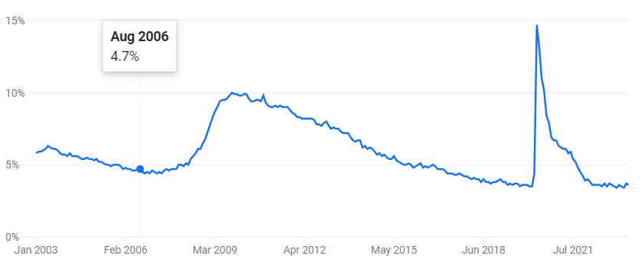
Unemployment Rate – Steady As She Goes

Slide 7
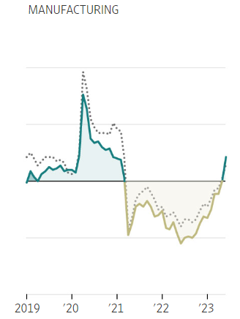
Head Winds Remain Stubborn

Slide 8
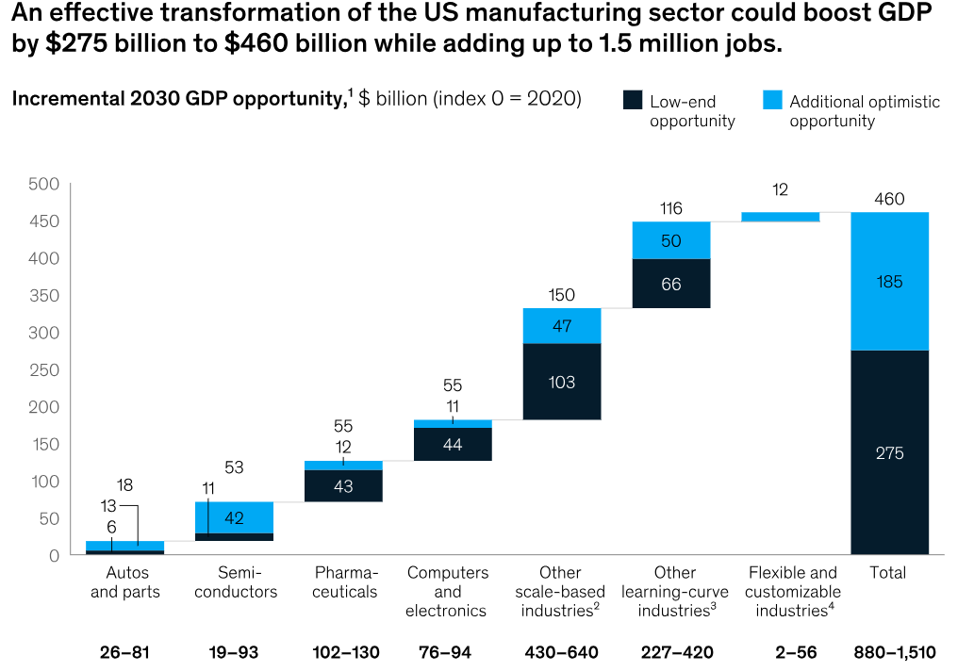
U.S. Manufacturing Renaissance – 2030 GDP Opportunity

Slide 9
Manufacturing Is Evolving
More Sustainable/Less Cyclical – Renewable Energy (technically and economically challenging)
More Digital – Advanced Manufacturing, A.I., Robotics
More Skilled – McKinsey projects 27% decline in physical and manual jobs replaced by increased demand for technological and cognitive skills
More Resilient – Building a domestic supply chain

Slide 10
Pasco Industrial Development Driver
Cushman & Wakefield Tampa Bay Land Market
INDUSTRIAL
“There is a shortage of larger and smaller owner/user industrial development sites. What land is available is pushing $30/building foot.

Slide 11
Additional Pasco Industrial Drivers
Access to Highways and Rail
Access to Major Consumer Markets
Access to Port of Tampa
Access to TIA
B2B – Life Sciences Hub

Slide 12
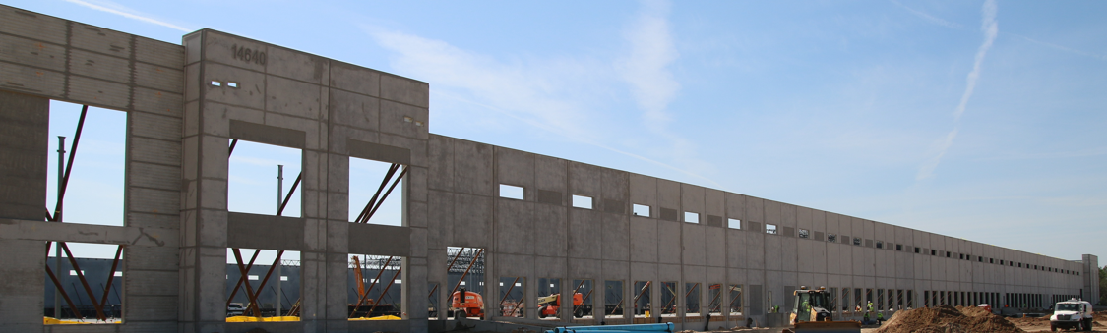
NOTABLE PROJECTS
Gary Plastics Corp. @ North Pasco Business Park

Slide 13
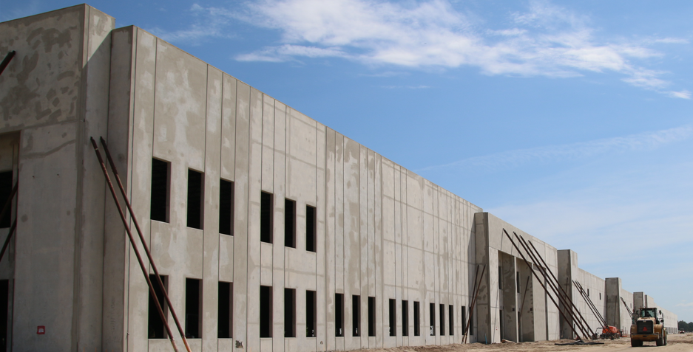
NOTABLE PROJECTS
Target Logistics Center

Slide 14
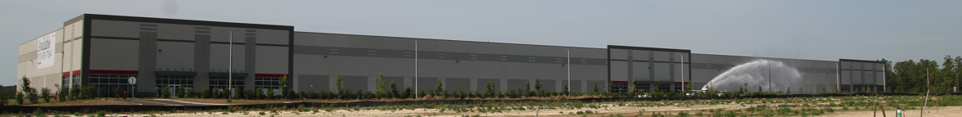
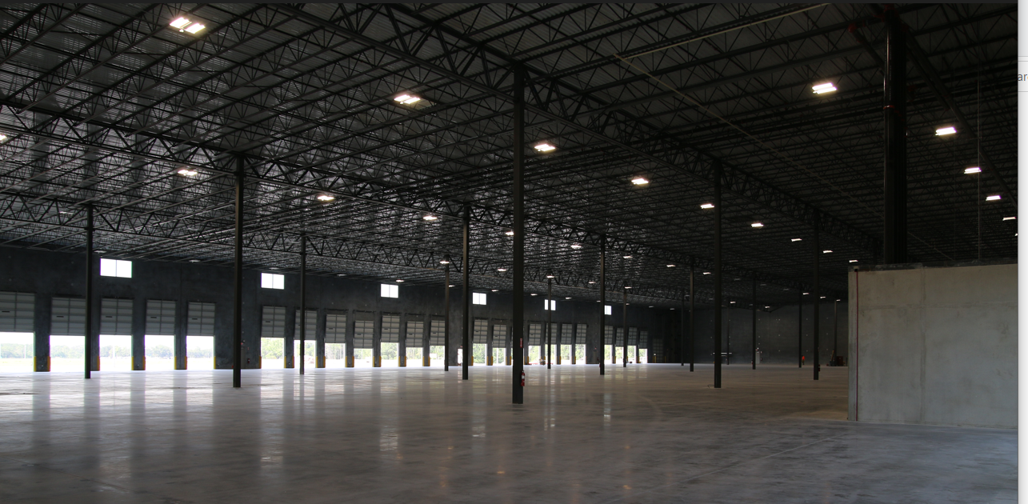
NOTABLE PROJECTS
North Tampa Business Park – Old Pasco Road

Slide 15
Thank You!
Questions?

Slide 16


Slide 17
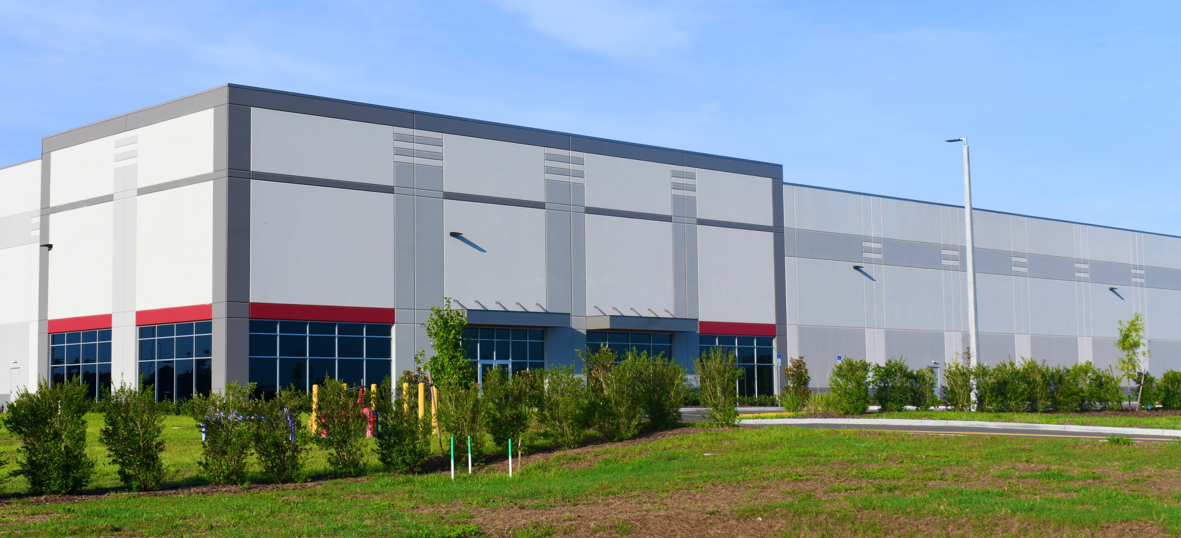


D E V E L O P E D B Y
BUILDING 1 SPECIFIC ATI ONS
187,000 SF (Divisible to 24,000 SF)
32’ Minimum Clear Height
69 Trailer Parking Slot
132 Car Parking Spaces
40 Dock-High Doors (9’x10’)
2 Drive-in Doors
60 Mil TPO Roof; R20 Insulation & 15-year Warranty
6” Reinforced Slab
ESFR Fire System
Tilt-Wall Construction
149,000 Local Residents Travel to Different County for Work Each Day (US Census)
NORTH TAMPA BAY 75 BUSINESS CENTER
7594 Old Pasco Road, Wesley Chapel, FL 33544

Slide 18
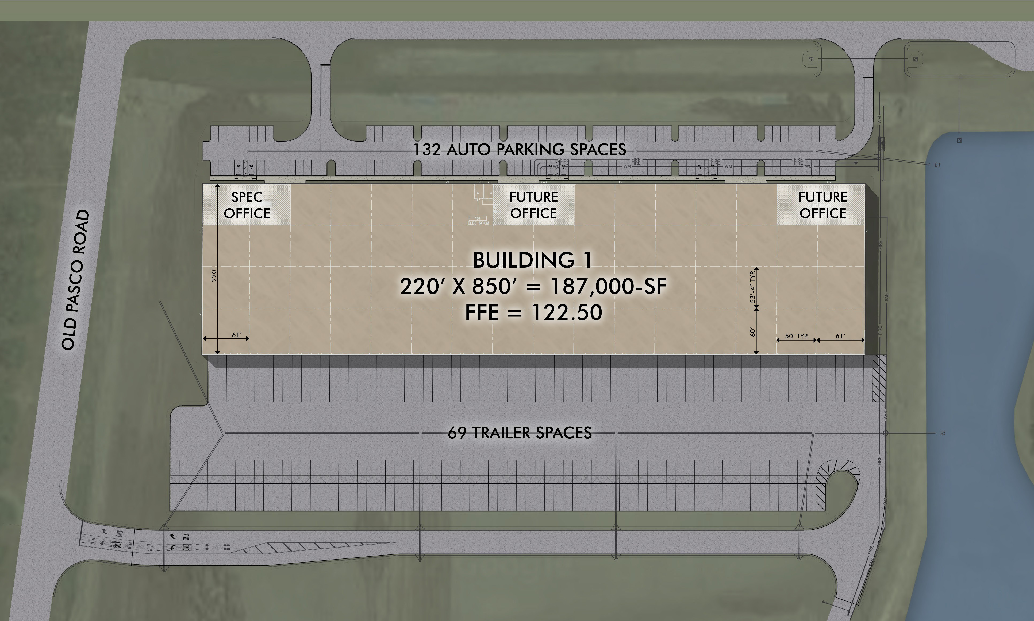
Site Plan
North Tampa Bay 75
Business Center
7594 Old Pasco Road, Wesley Chapel, FL 33544

Slide 19
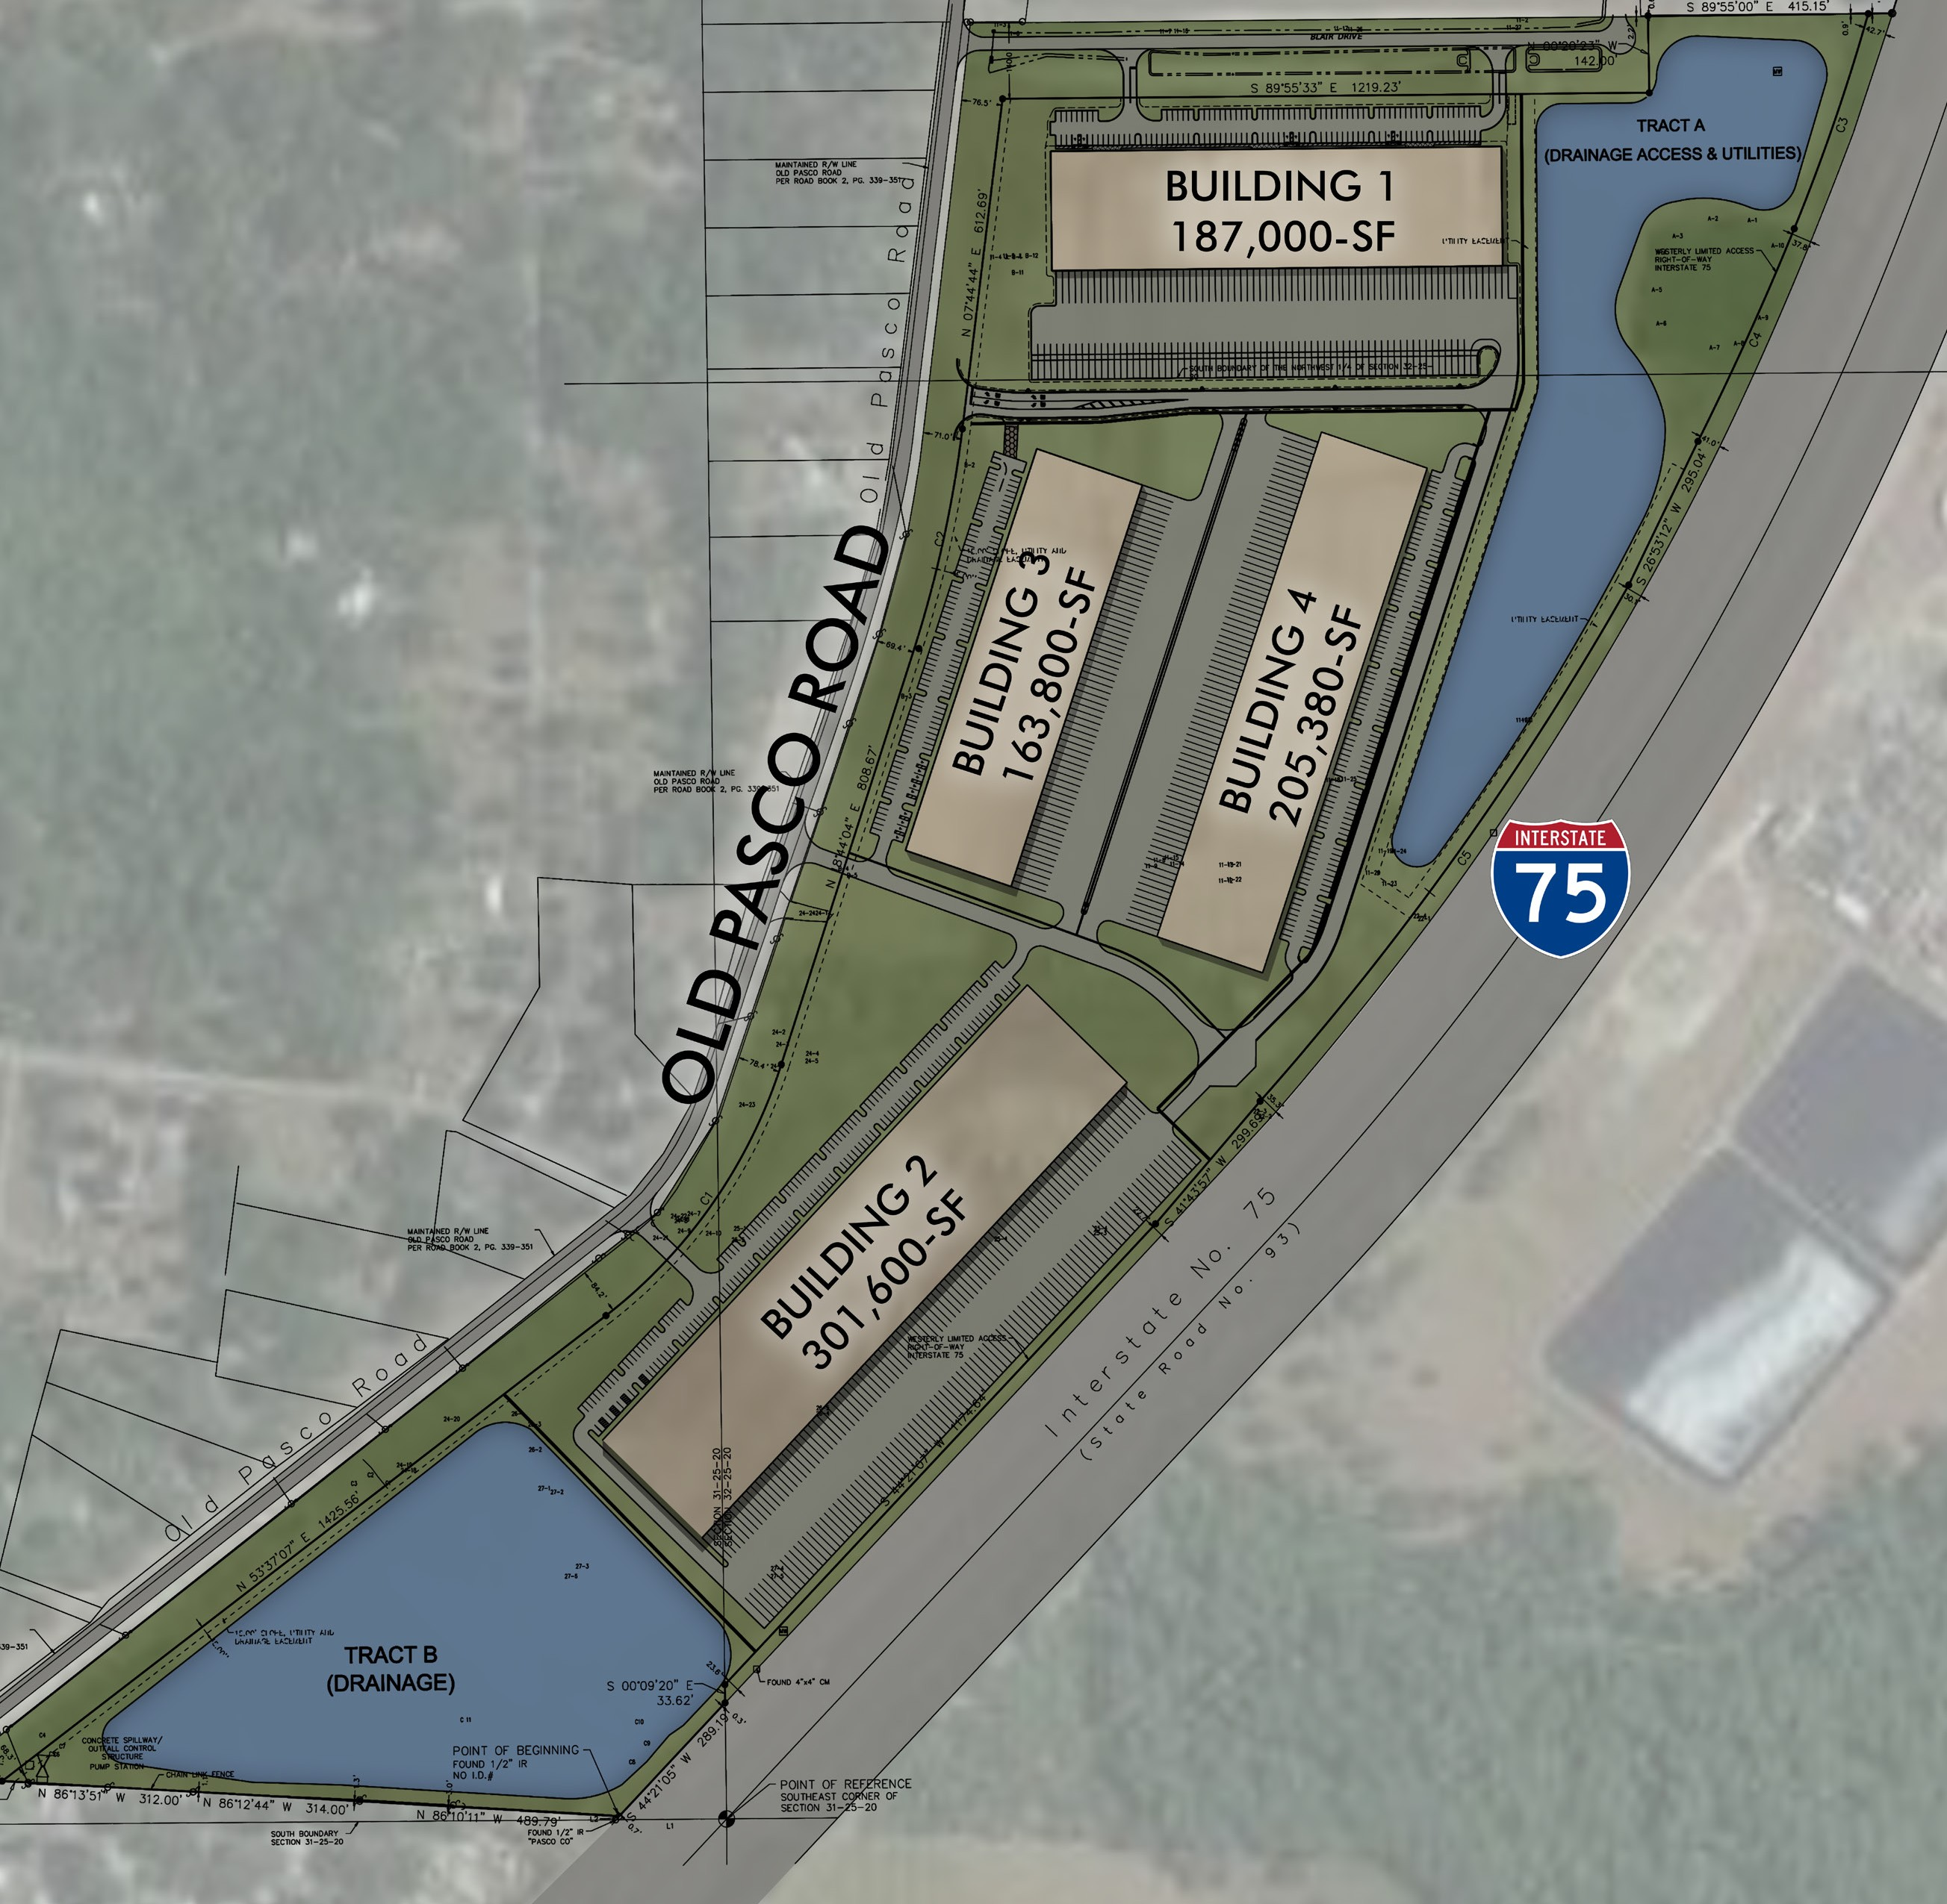
Site Plan
North Tampa Bay 75
Business Center
7594 Old Pasco Road, Wesley Chapel, FL 33544

Slide 20
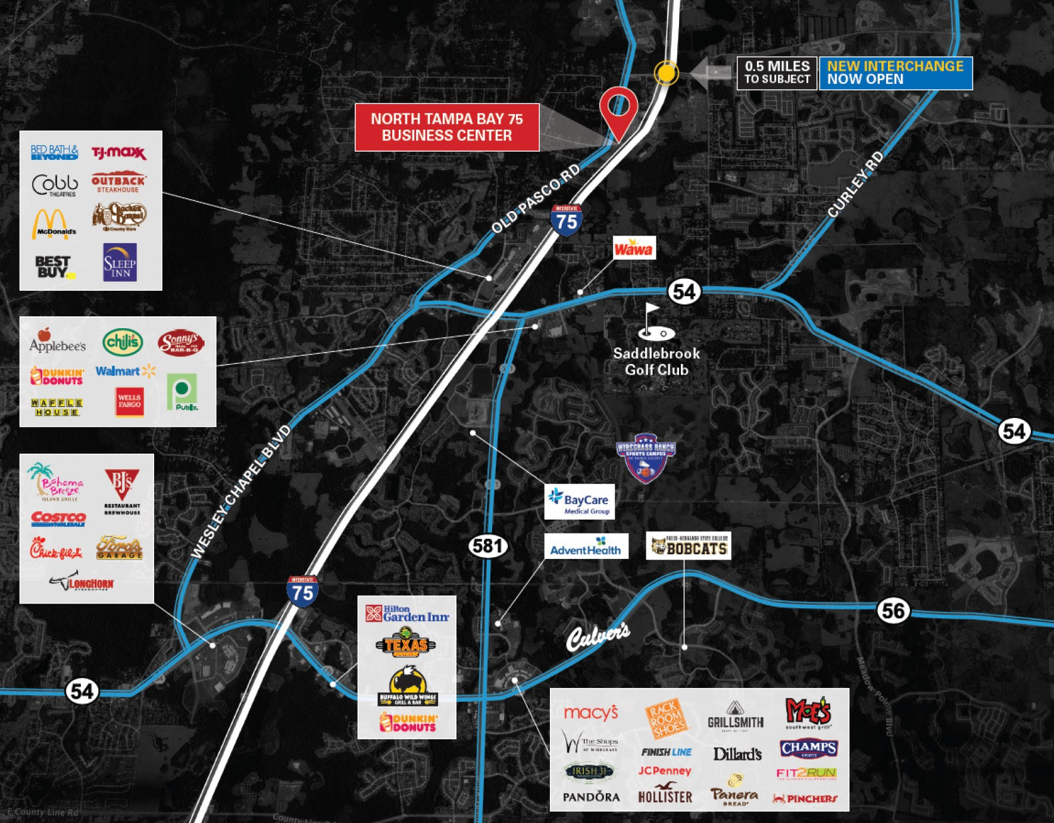
Area Overview
North Tampa Bay 75
Business Center
7594 Old Pasco Road, Wesley Chapel, FL 33544

Slide 21



For more information:
RICK NARKIEWICZ, SIOR
Senior Managing Director
t 813-830-7884
rick.narkiewicz@nmrk.com
TAMPA
4221 W. Boy Scout Boulevard Suite 440
Tampa, FL 33607
nmrk.com
NORTH TAMPA BAY 75 BUSINESS CENTER
7594 Old Pasco Road, Wesley Chapel, FL 33544

Slide 22
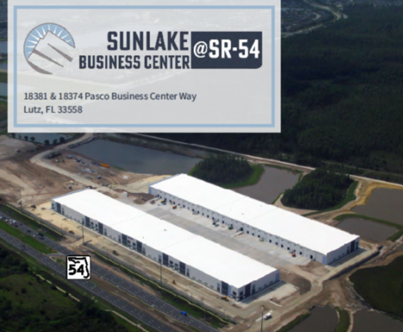


Slide 23
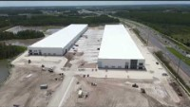

Slide 24
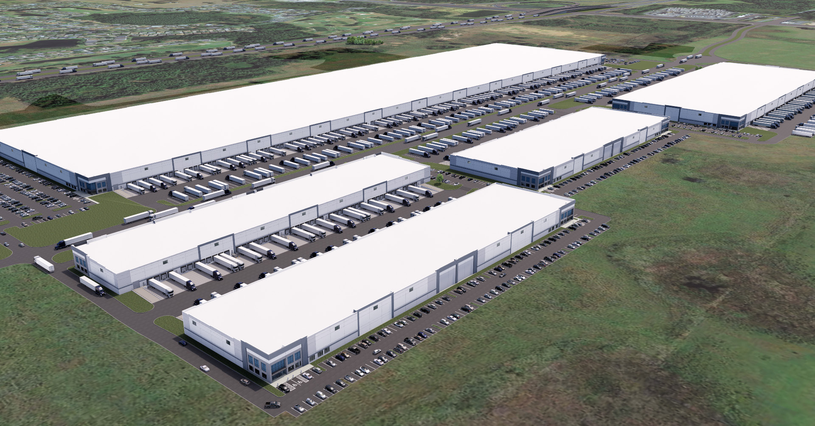
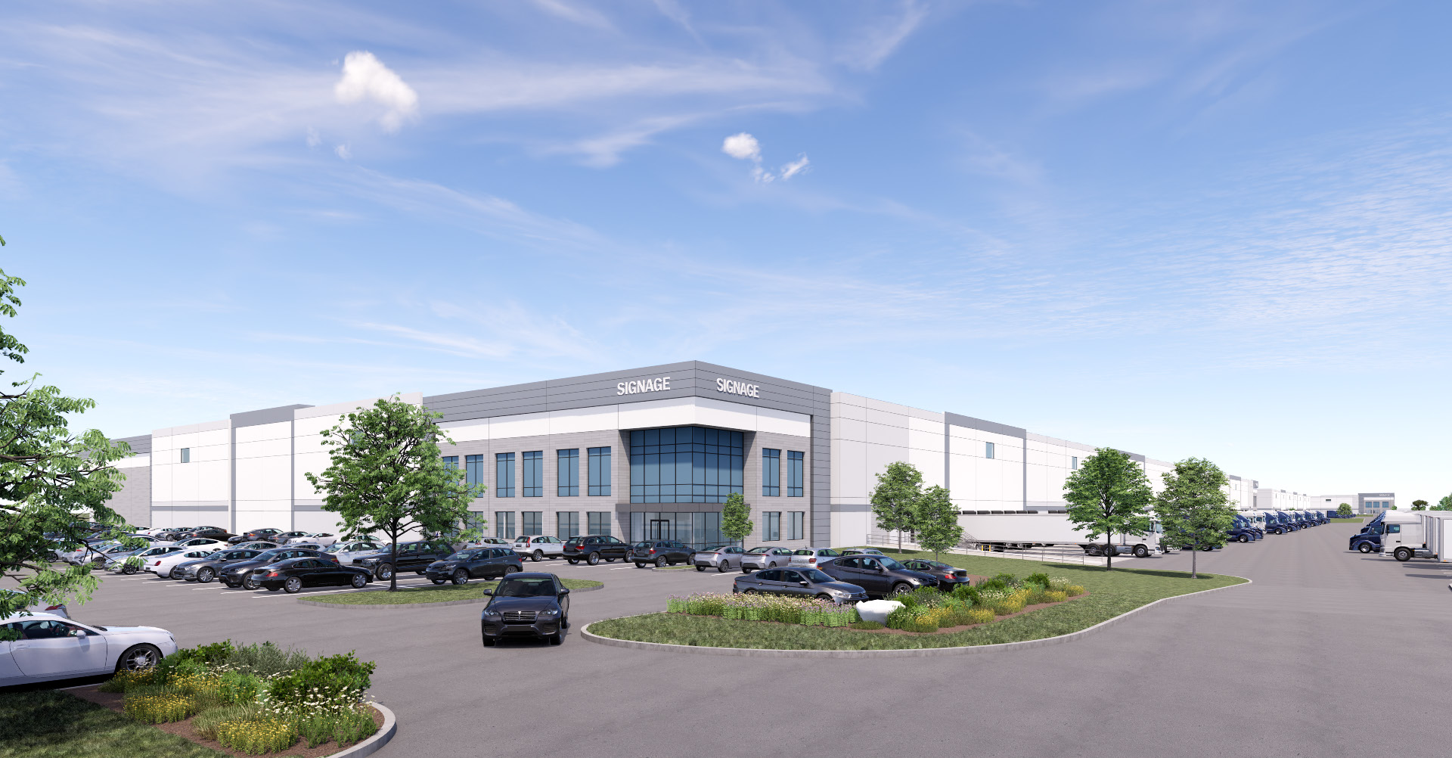


75
PTC 75
INDUSTRIAL
Central Florida | Intersection of I-75 & SR-52
75,000 to 1.6M SF Leasing Opportunities
Pasco Town Center 75 Industrial

Slide 25



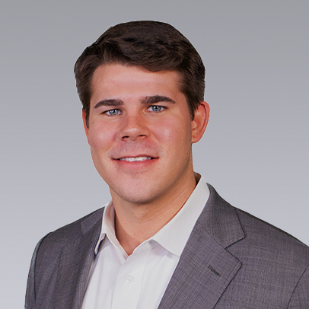






Colliers Central Florida Leasing
Robyn Hurrell, SIOR
Executive Vice President
Oliver Vaubois
Senior Associate
Harrison Pithers
Associate
Emory Lay
Marketing & Client Services Specialist
Colliers SE Capital Markets
Columnar Holdings
Ryan Vaught
Executive Vice President
Riley Vaught
Associate
Matt Omundson
COO/Partner
Mike Wolf
SVP of Land

Slide 26
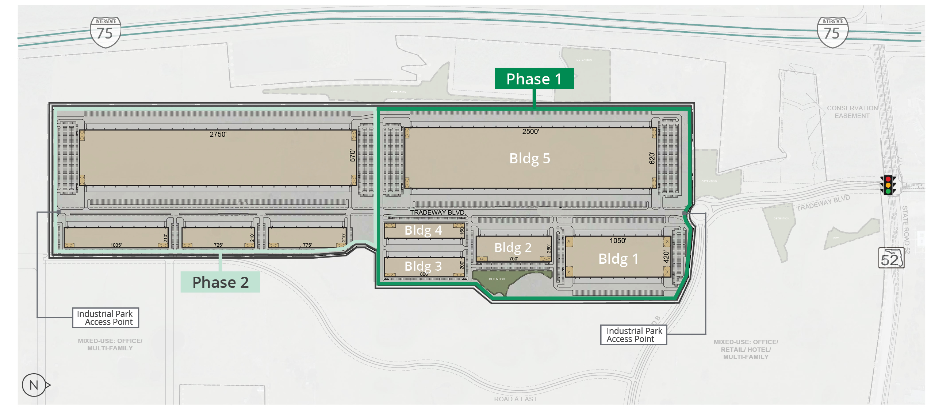
Site Plan | Phase 1
Entitled for up to 4.5M square feet of total industrial and accommodating occupiers requiring 75,000 SF to 1,600,000 SF, Columnar will be kicking off the site’s industrial development with Phase 1 (Buildings 1-5). With full entitlements in hand and design/permitting underway, site clearing is scheduled to begin late Q3 2023.

Slide 27
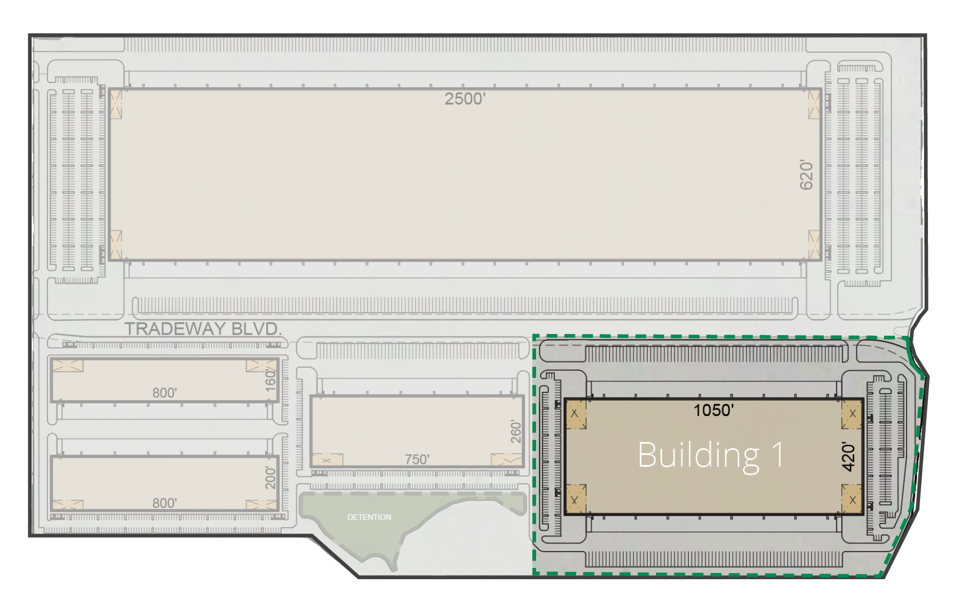
Building 1 | Phase 1
Building Size: | ±441,000 SF
Office: | BTS
Building Type: | Cross-Dock
Building Dimensions: | 1050’ wide x 420’ deep
Clear Height: | 40’ minimum
Speed Bay: | 60’
Column Spacing | 50’(d) x 56’(w) - interior 50’(d) x 49’(w) - exterior
Truck Court: | 185’ deep (55’ trailer stall)
Drive-in Doors: | 4 (14’ x 12’)
Dock -High Doors | 104 (9’ x 10’)

Slide 28


N

Slide 30
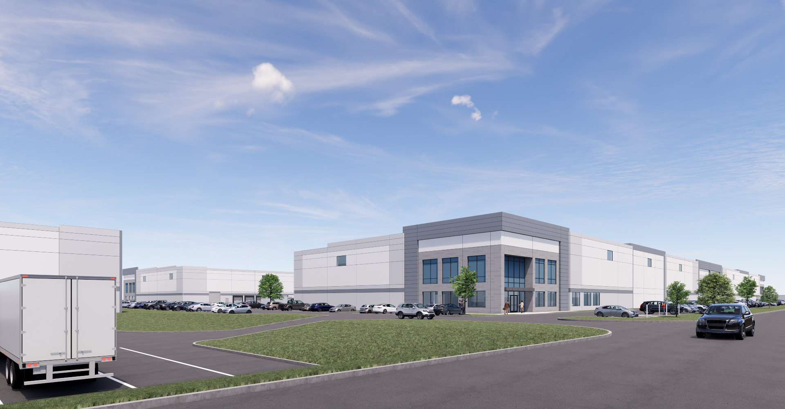

Slide 31
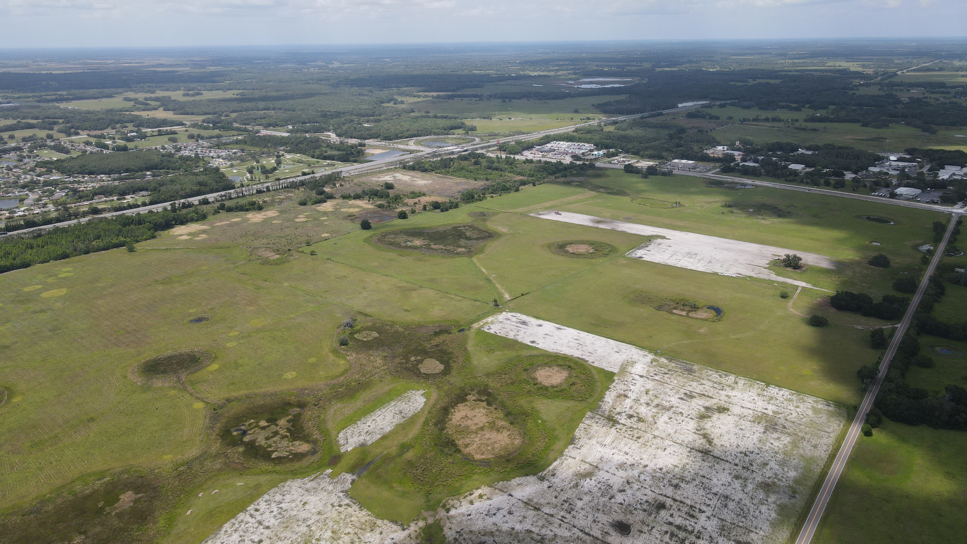

N

Slide 32
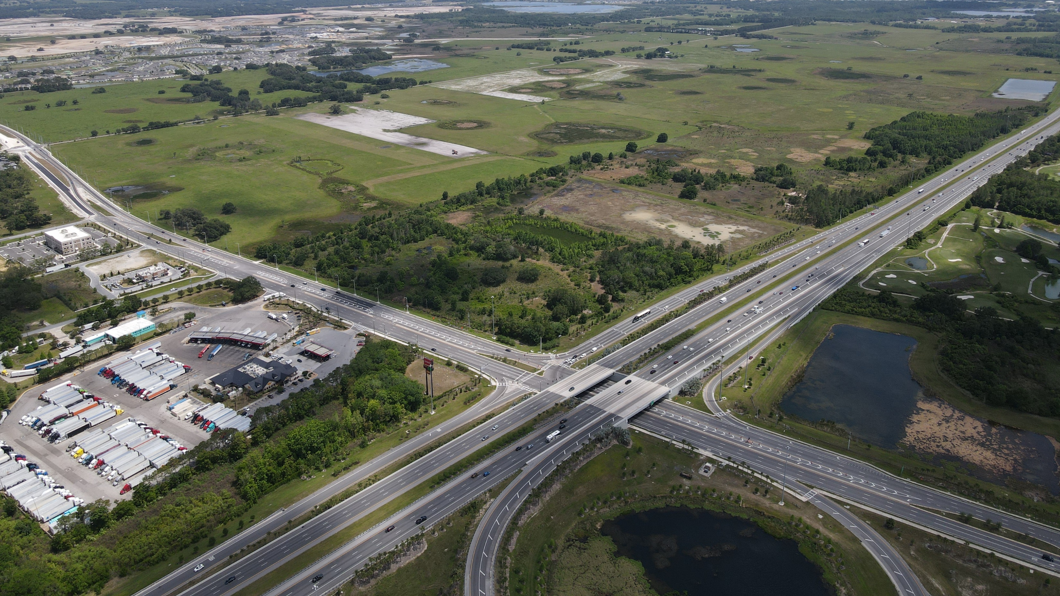
N

Slide 33
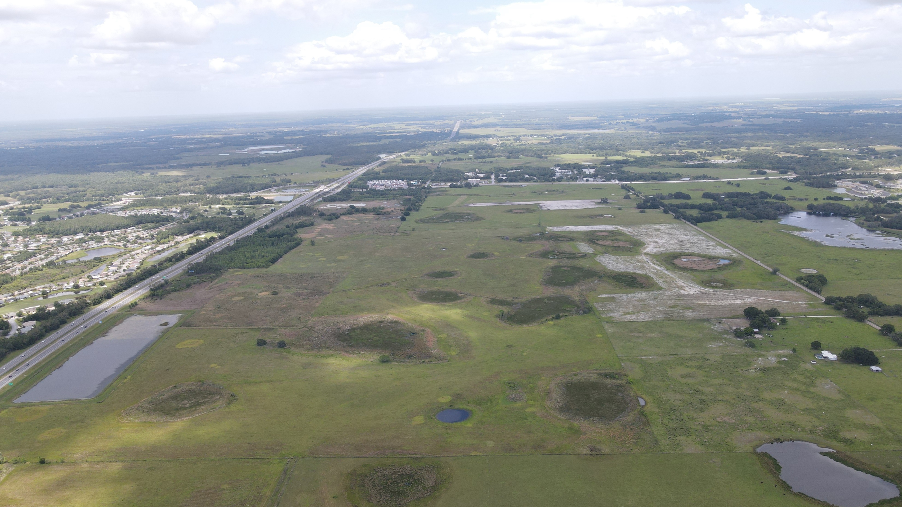
N

Slide 34
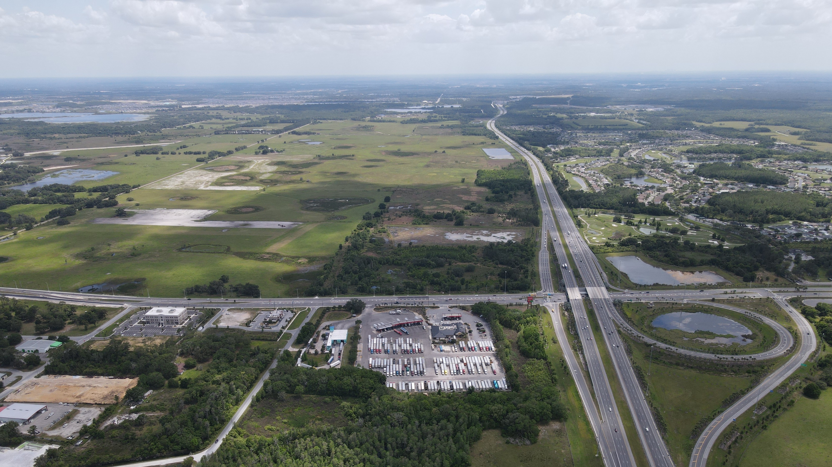
N

Slide 35
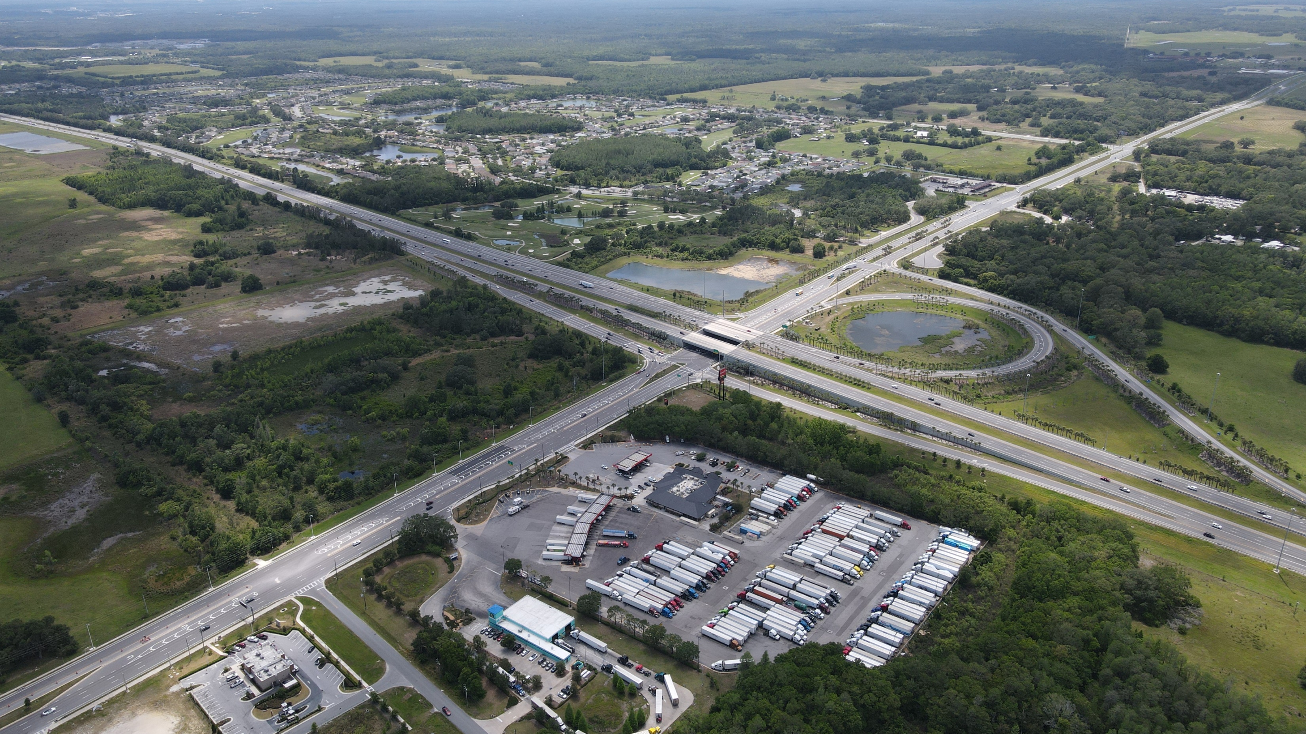
N

Slide 36
N

Slide 39
N

Slide 40
N

Slide 41
N

Slide 42
N

Slide 43
N

Slide 44
N

Slide 47
N

Slide 48
N

Slide 49
N

Slide 50
N

Slide 51
N

Slide 52
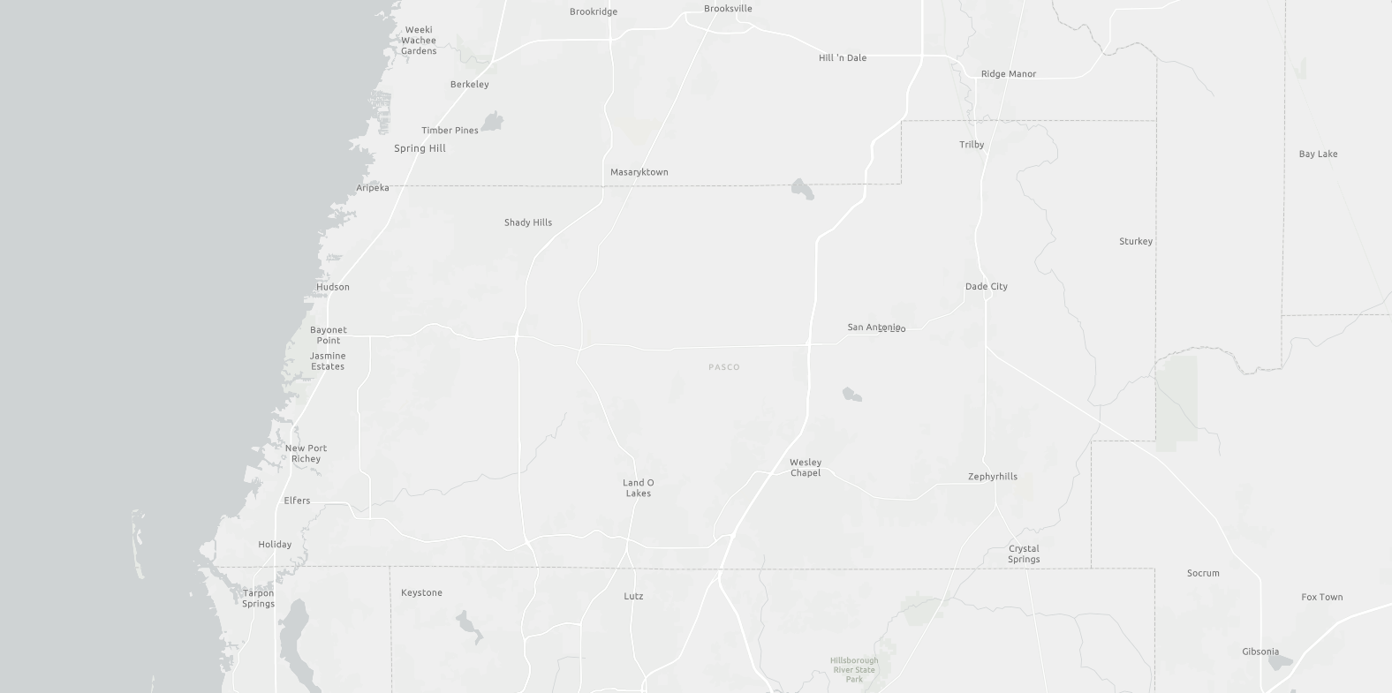
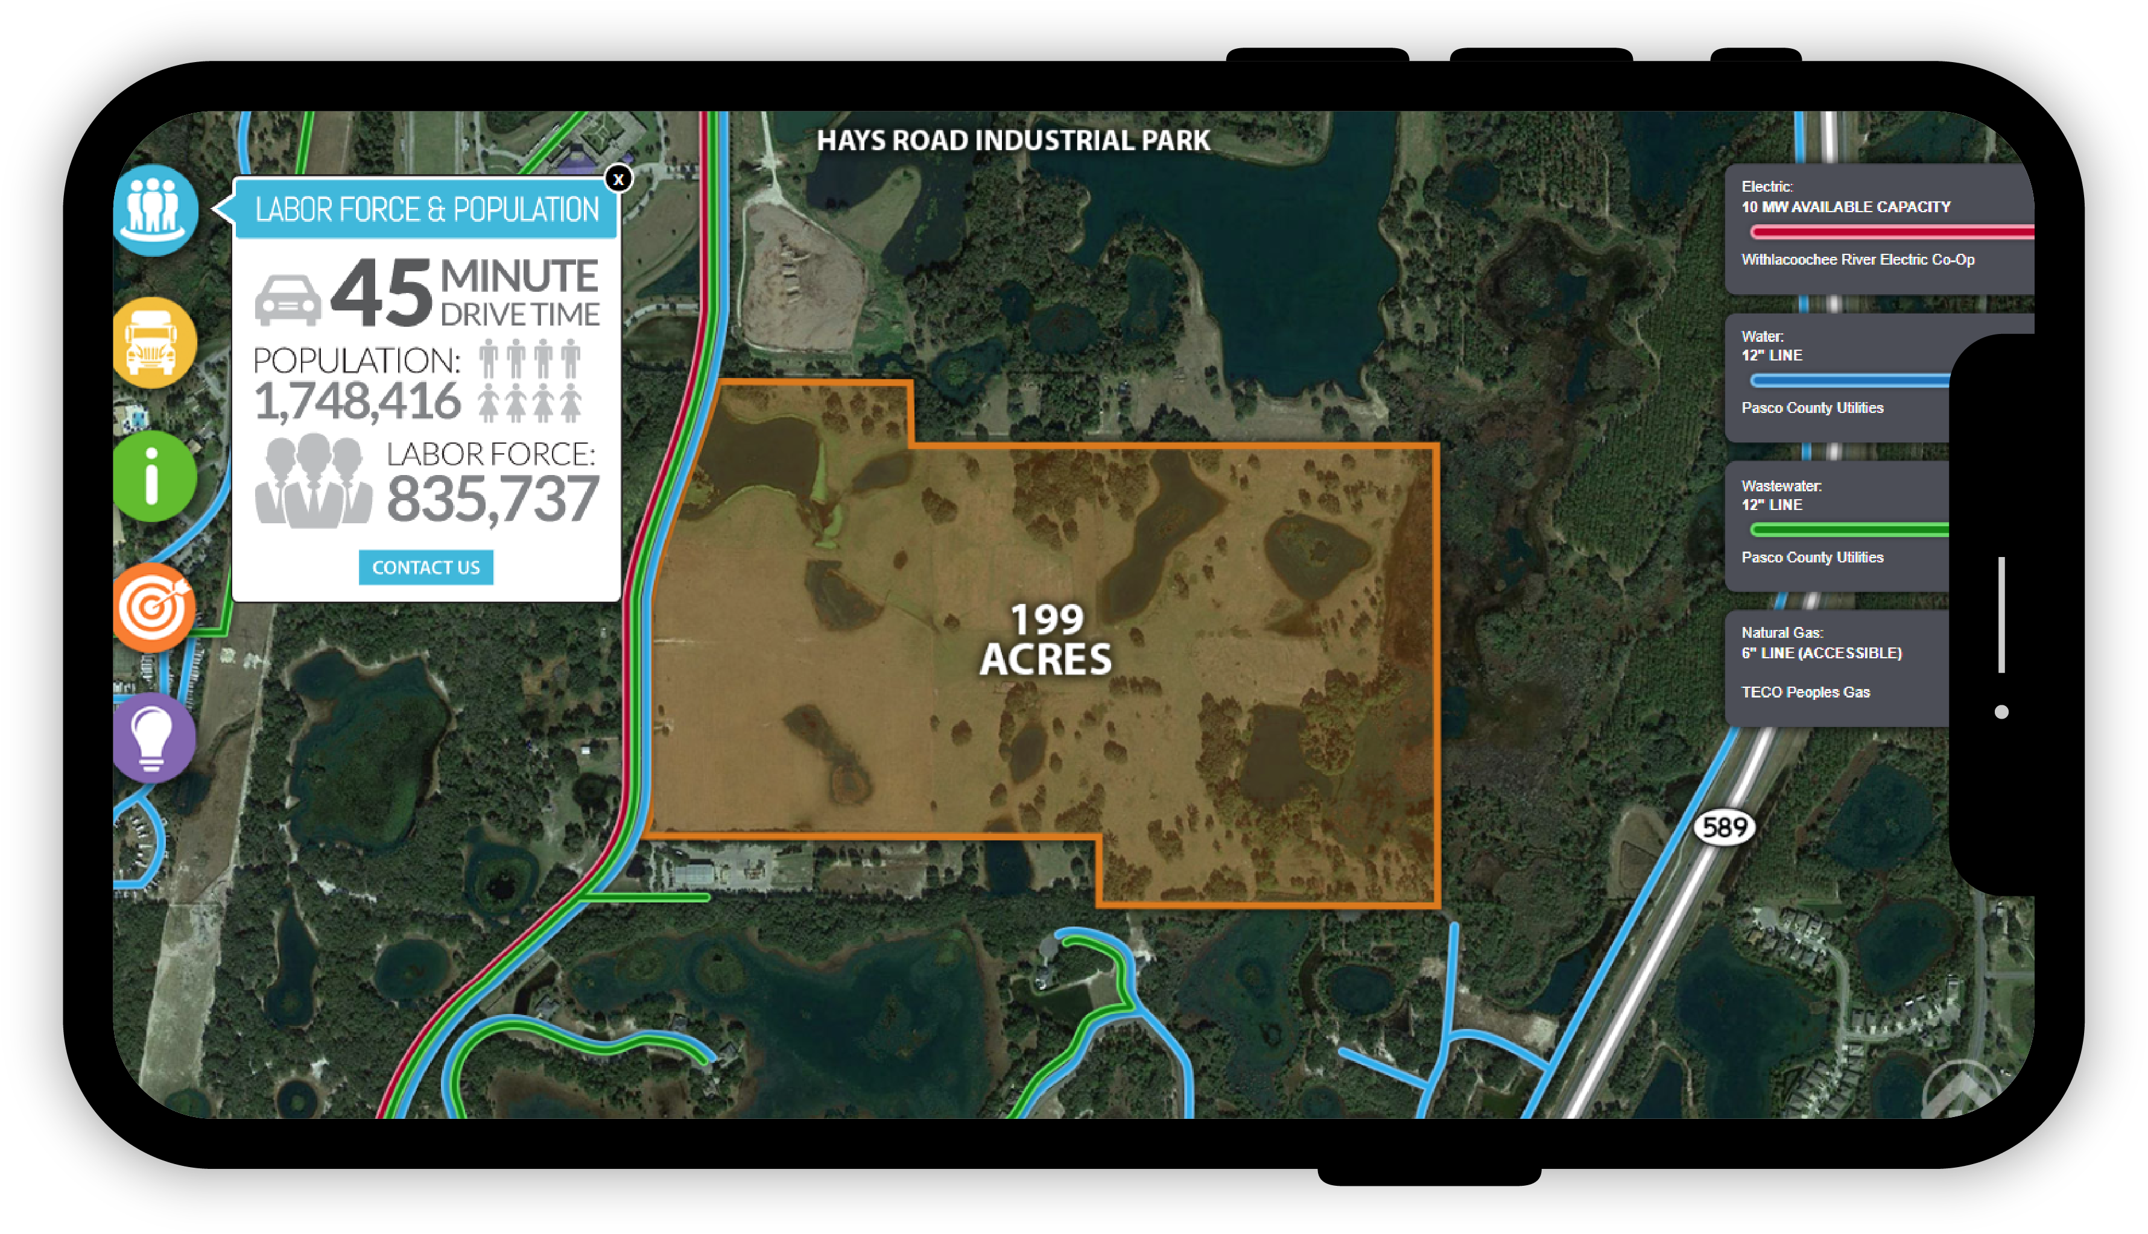


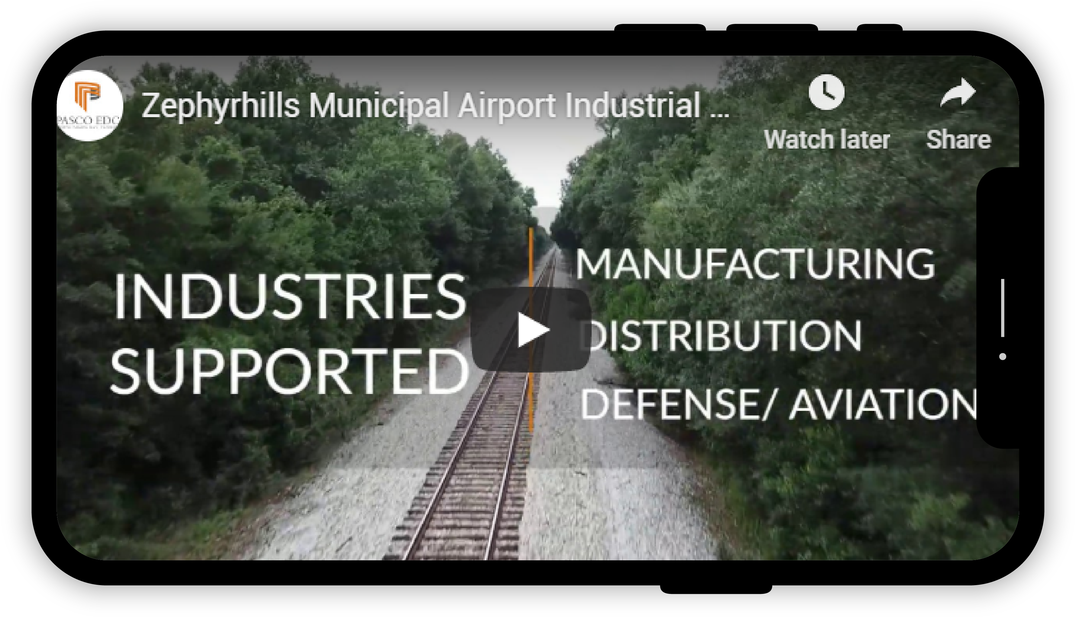
Pasco ready sites
The Ready Sites Program accesses, evaluates, and certifies large tracts of land to prepare properties for industrial development and create a portfolio of project-ready sites for targeted industries.
There are currently over 2,000 acres of land in the program. Each site features numerous digital tools for site selectors to utilize and tour the site.

Slide 53
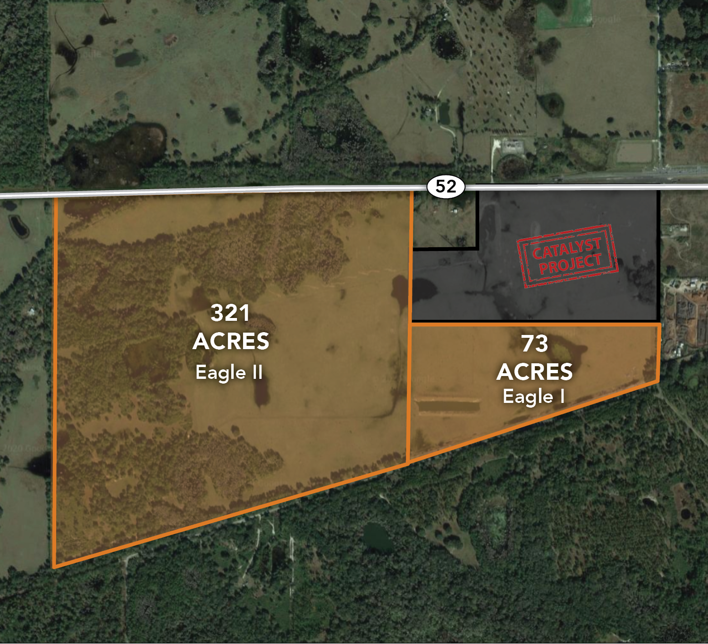
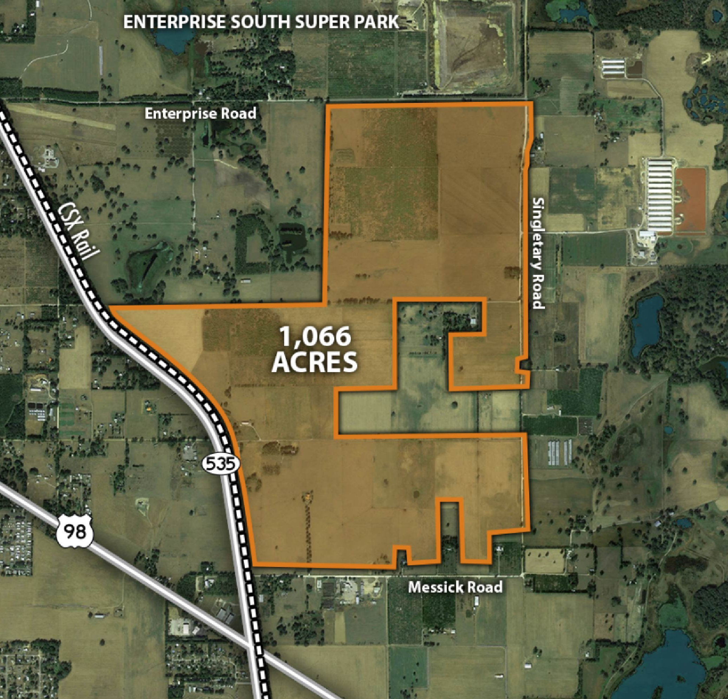
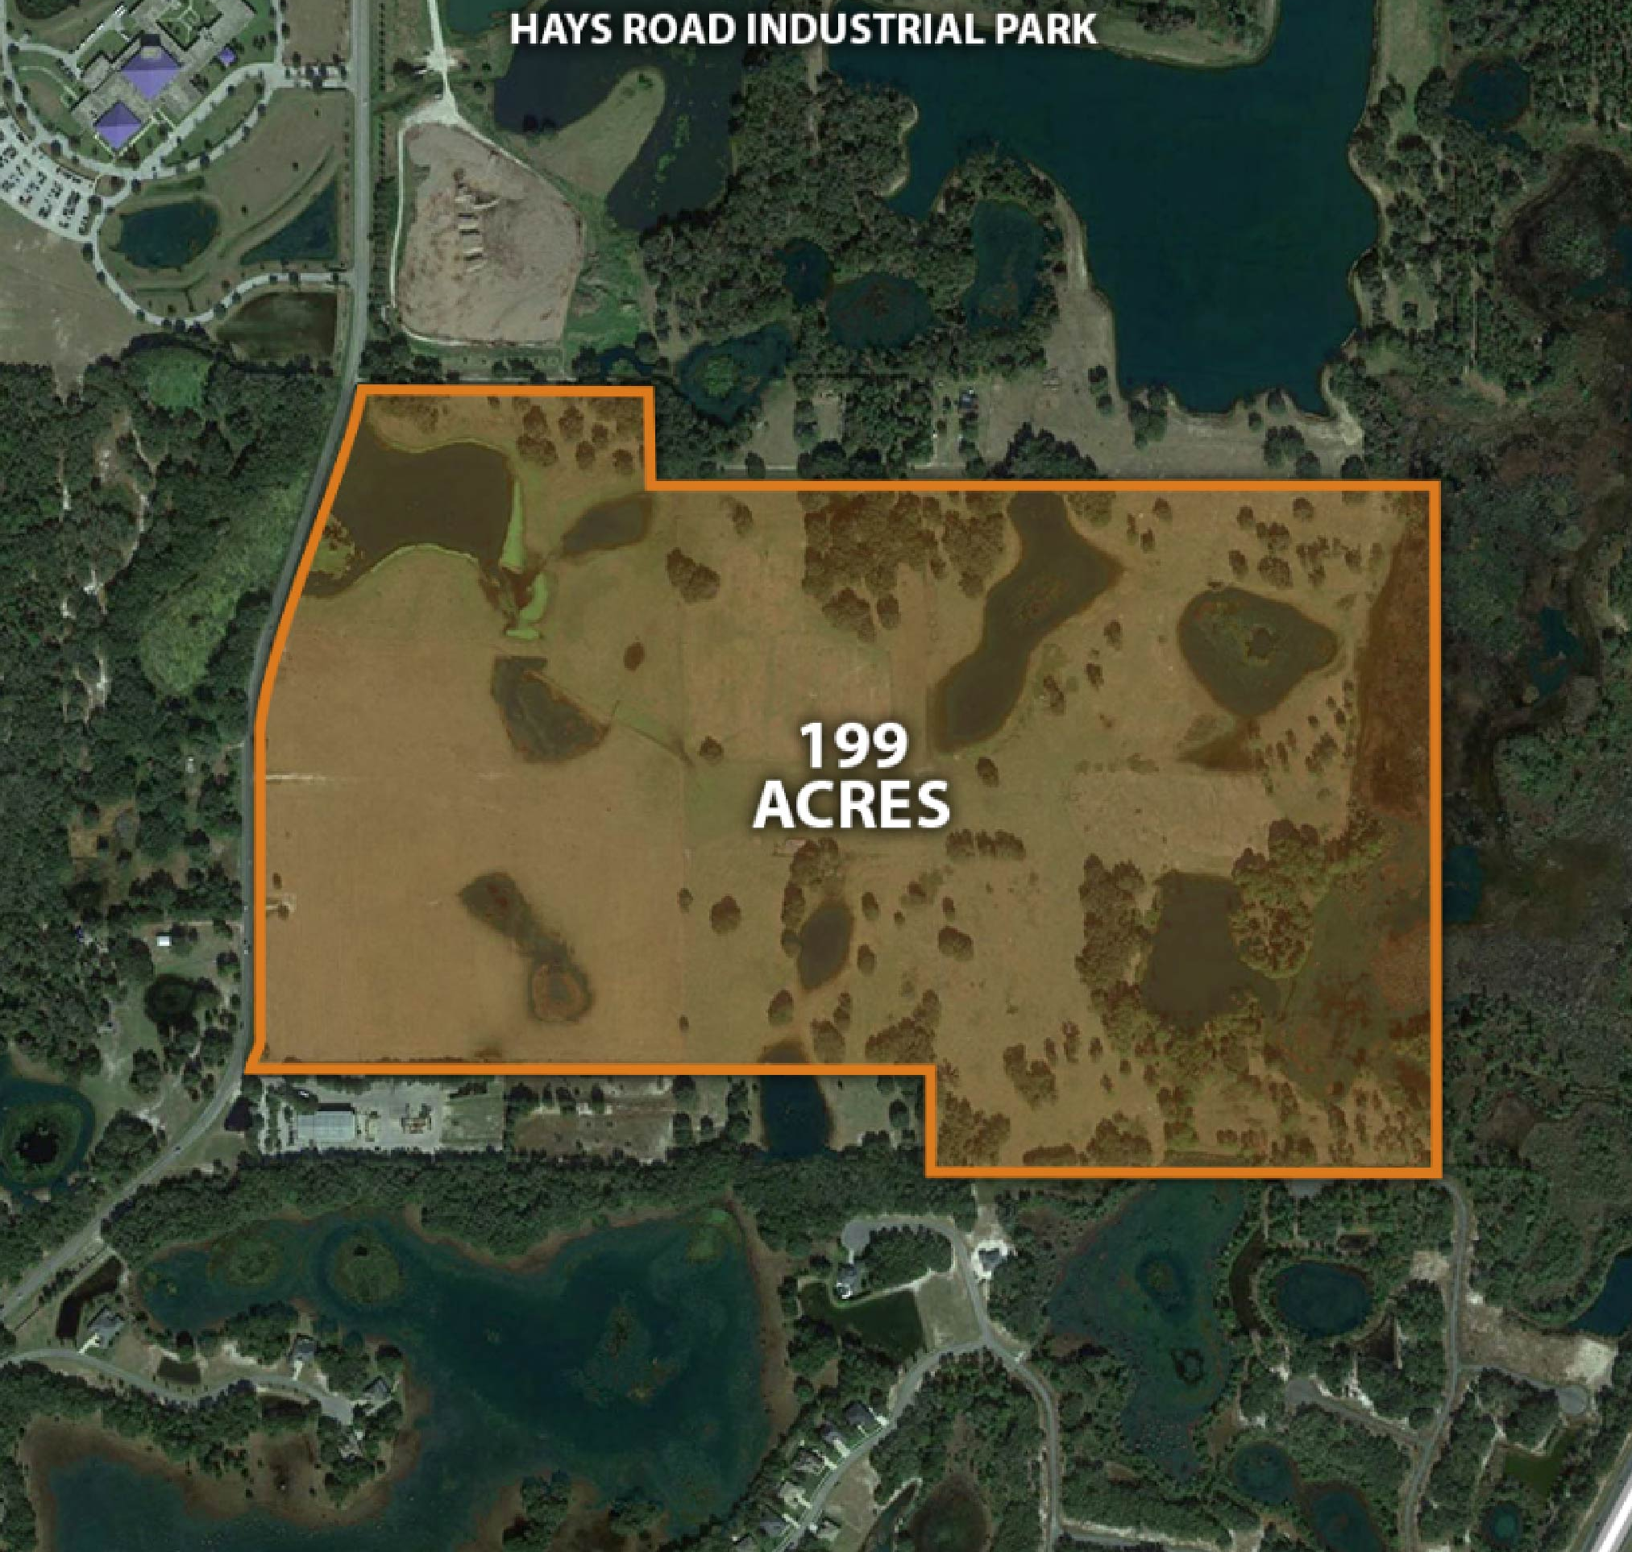
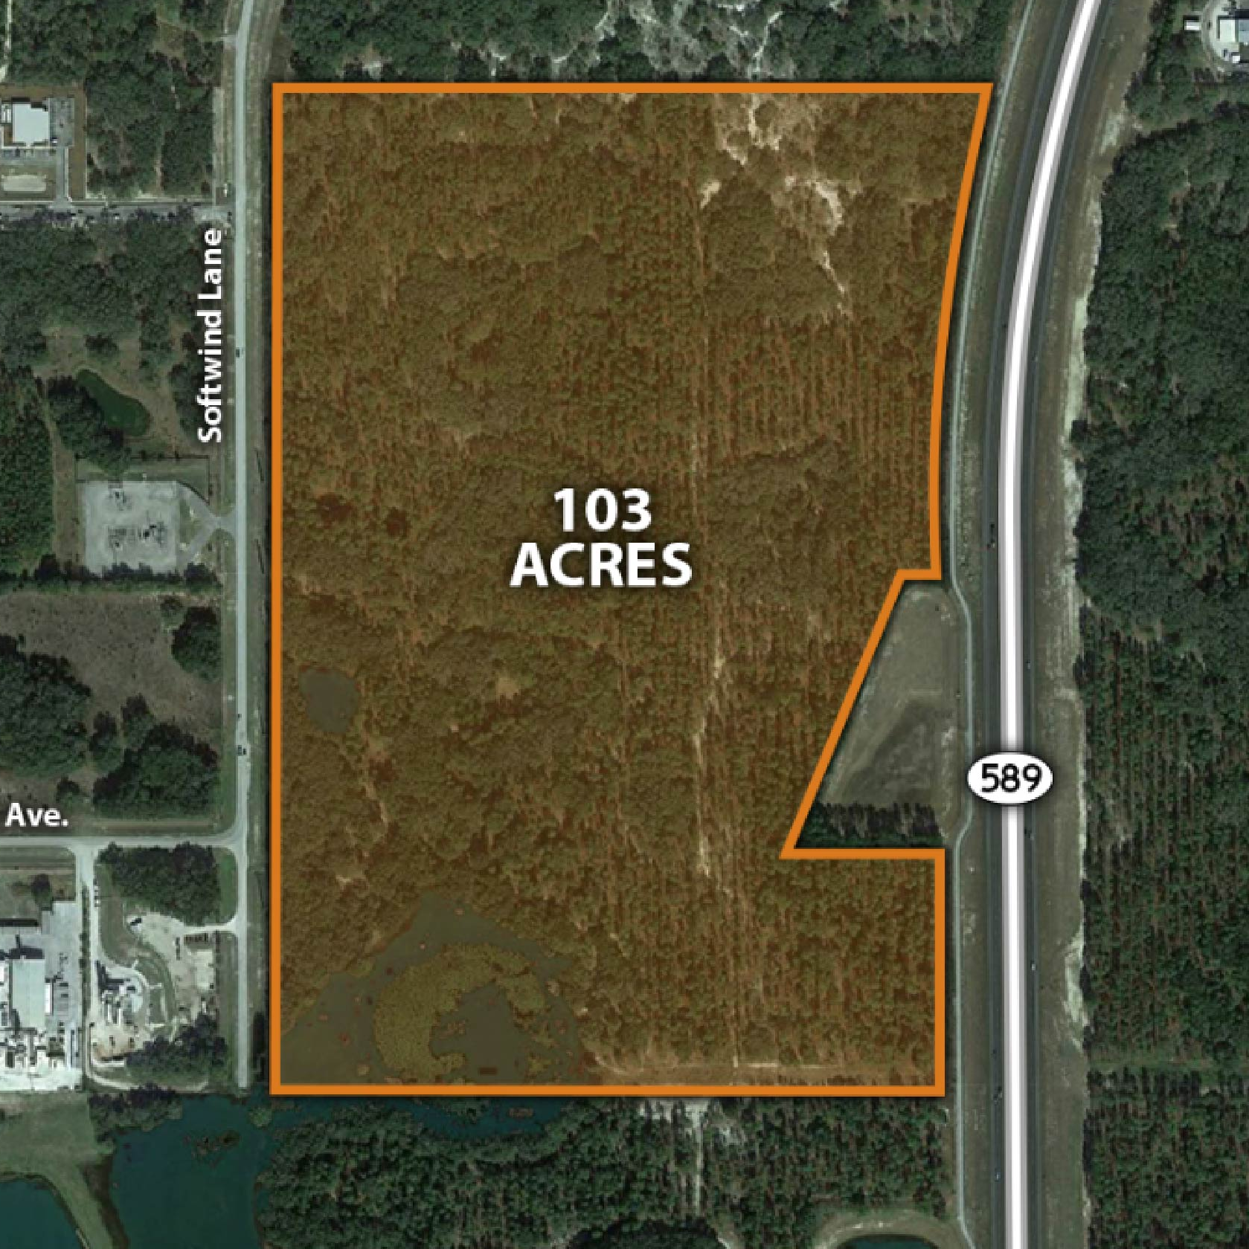
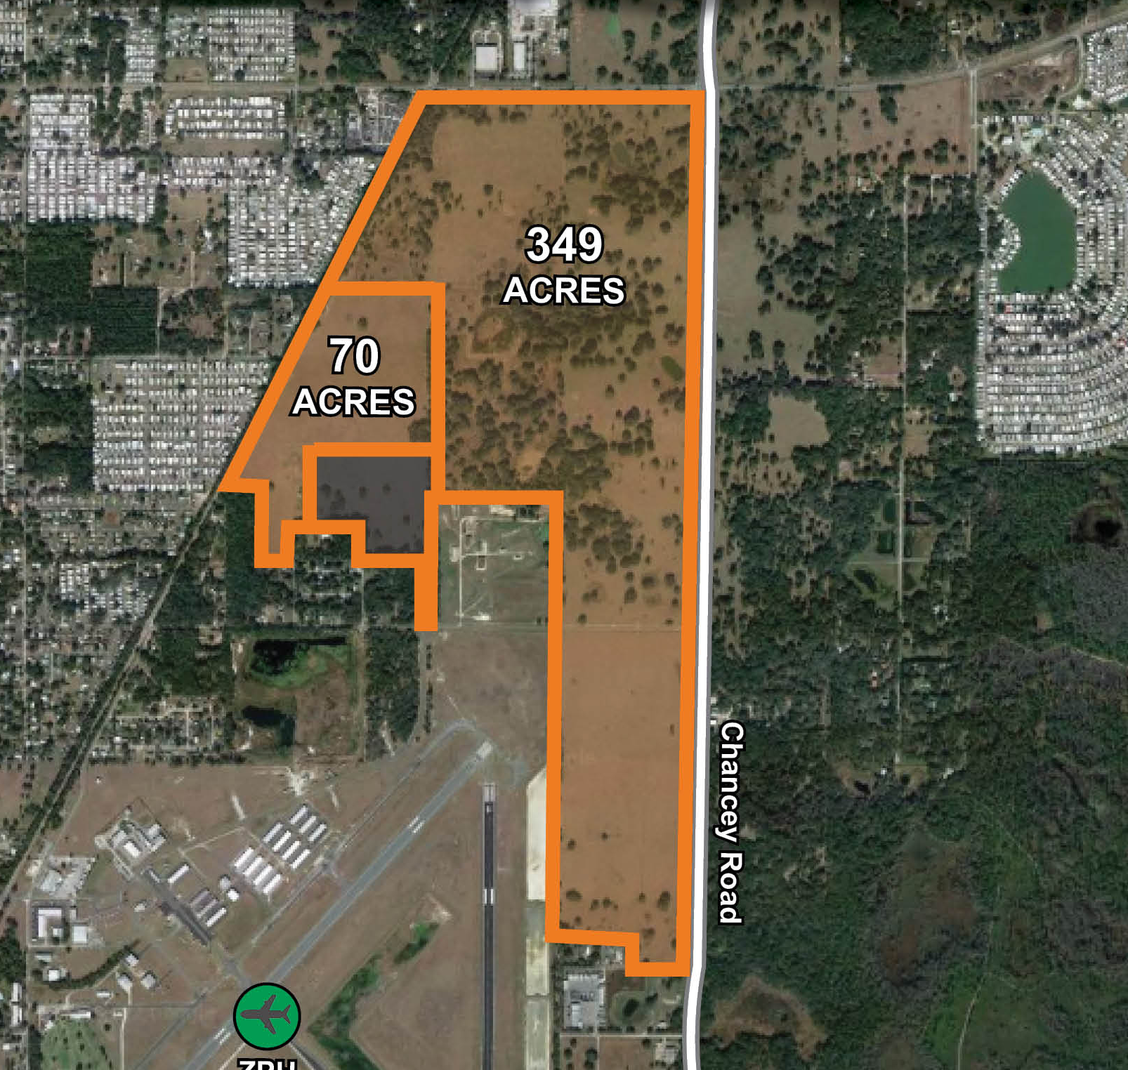
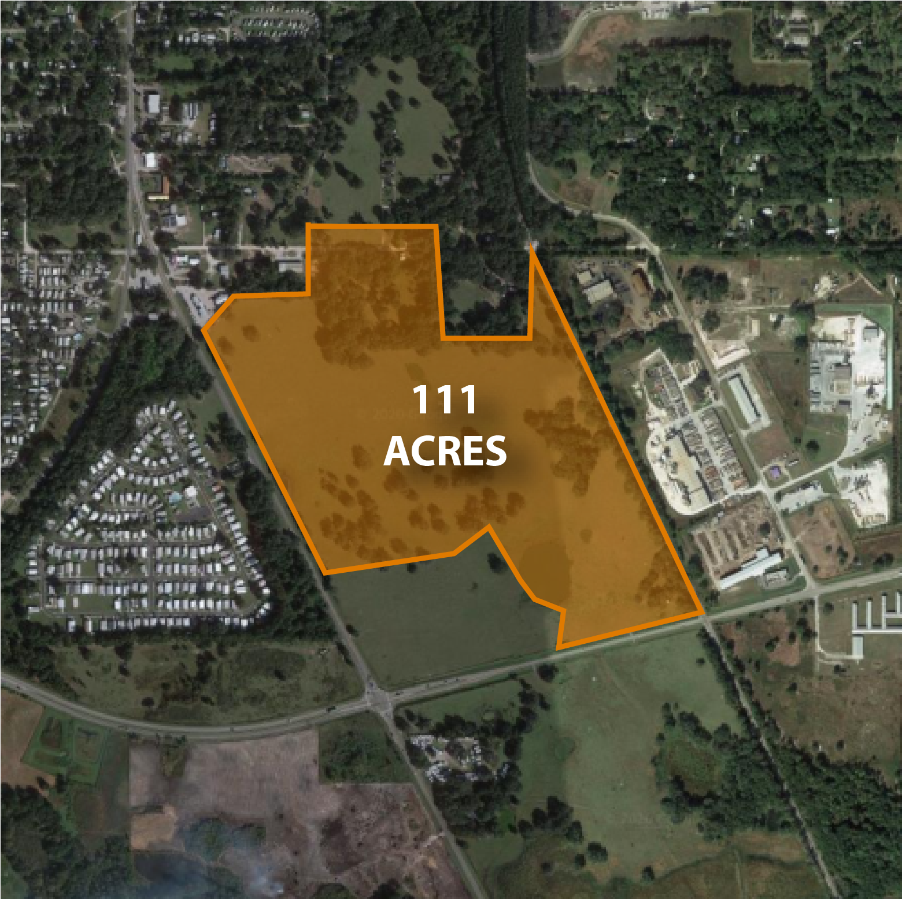
READY SITES PROGRAM
EAGLE I & II
INDUSTRIAL PARKS
ENTERPRISE SOUTH
SUPER PARK
HAYS ROAD
INDUSTRIAL PARK
SOFTWIND
INDUSTRIAL PARK
ZEPHYRHILLS AIRPORT INDUSTRIAL PARK
NORTH TAMPA BAY INDUSTRIAL PARK

Slide 54
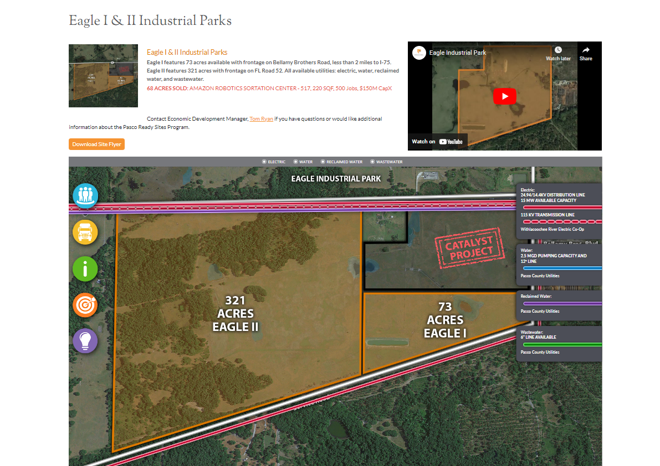
READY SITES PROGRAM
SITE TOOLS:
Property Flyers
Videos
Interactive Maps Featuring:
  Utility Location & Capacity
  Total Acreage
  Transportation Networks
  Workforce & Population Data
  Land-Use

Slide 55
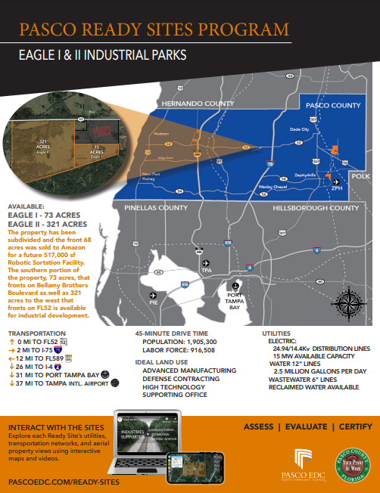
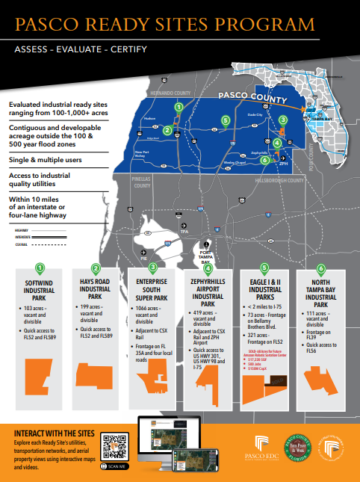
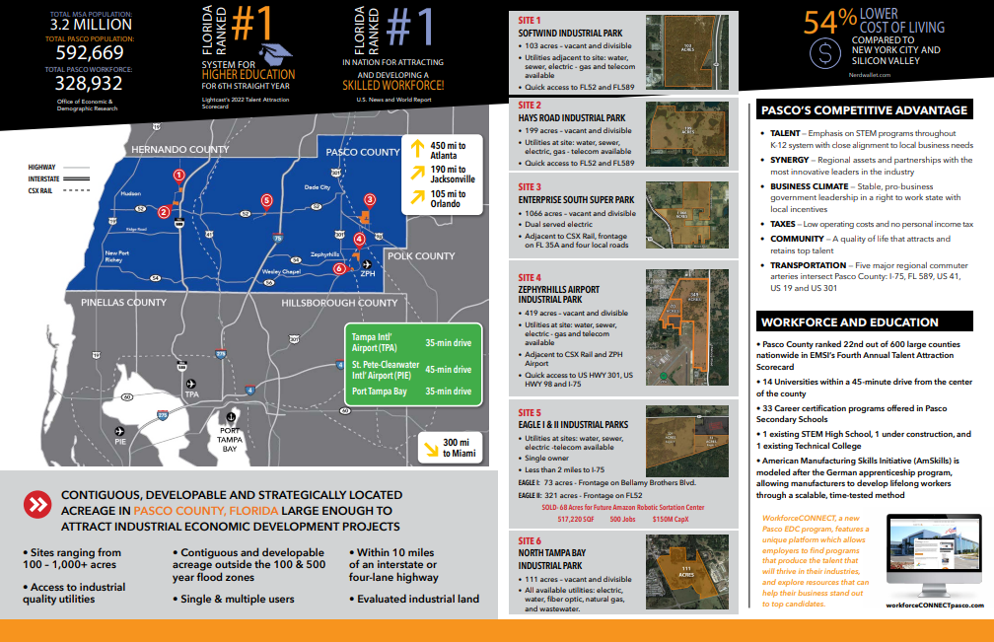
READY SITES PROGRAM

Slide 56
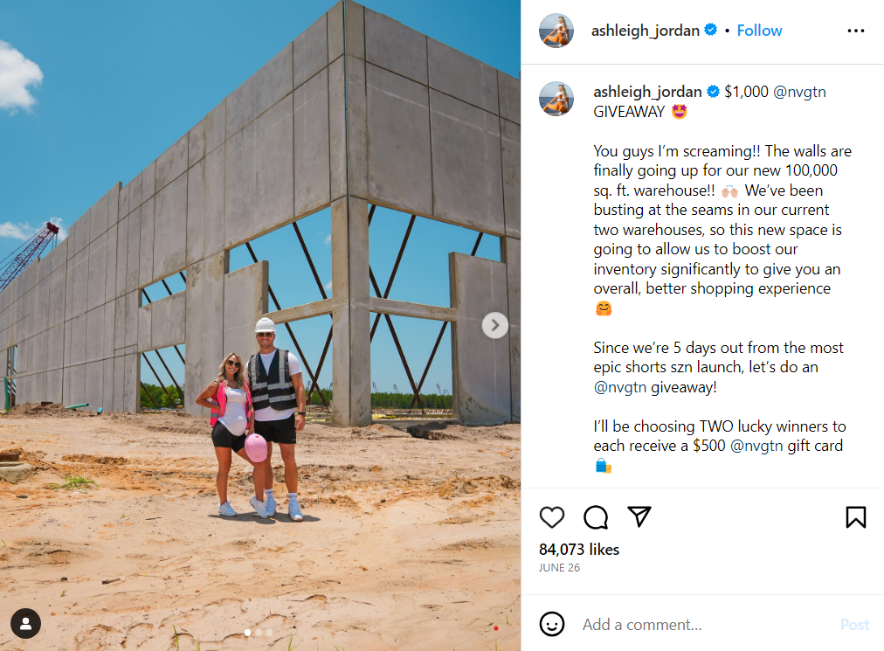
Recent ANNOUNCEMENTS

Slide 57


THANK YOU
Tom Ryan, CEcD
Director of Business Development
Pasco EDC
tryan@pascoedc.com
www.pascoedc.com

