Slide 1
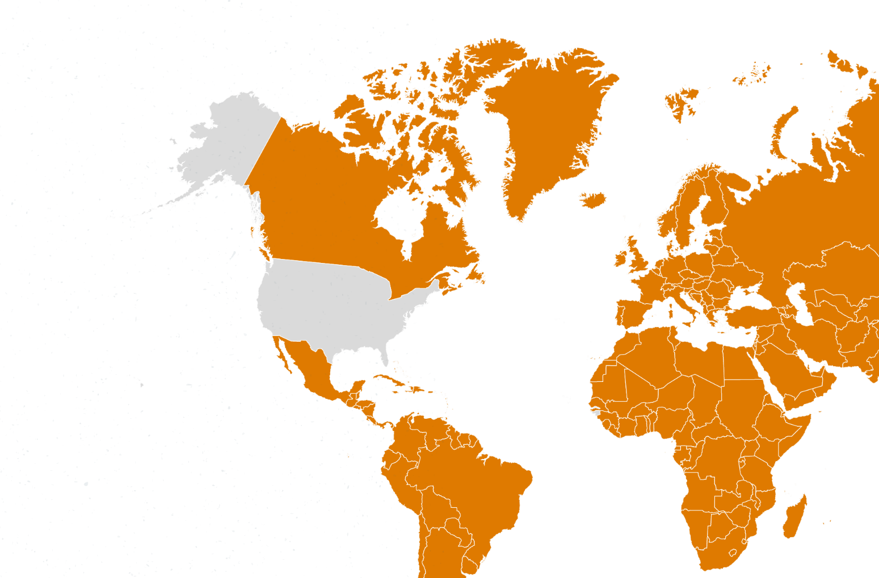
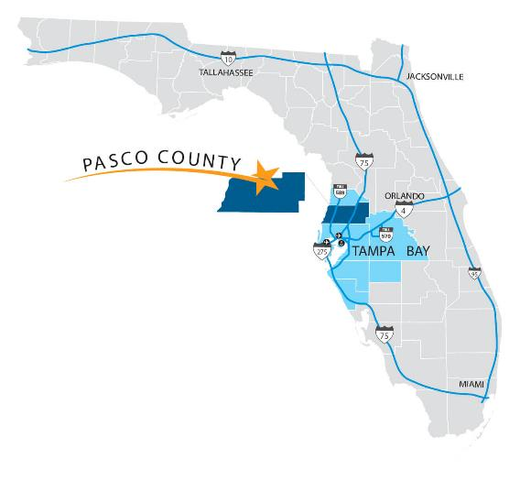
Pasco county, Florida, u.s.a.
Pasco Economic Development Council
501 (c) 3 non-profit corporation
Public-Private Partnership
Incorporated in 1987
Pasco County, FL
Notes:
Start by orienting crowd of where we are talking about
World -> USA -> Florida -> Tampa Bay -> Pasco
Proximity to the client
*Overall, every slide should have an advantage to locating here and answer the “why”.

Slide 2
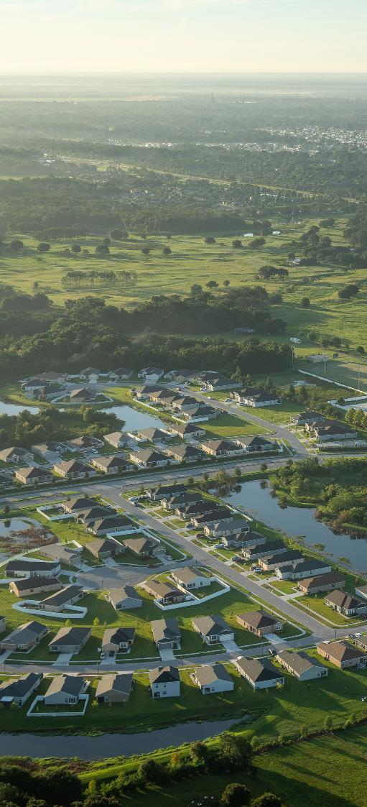
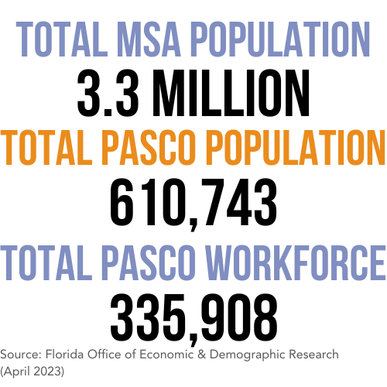
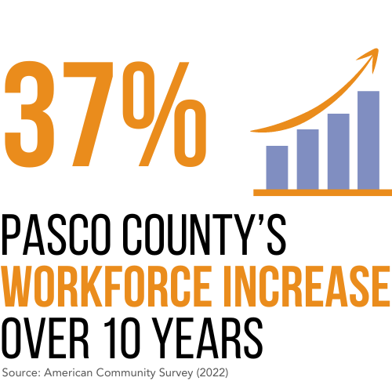
PASCO COUNTY PROFILE

Slide 3
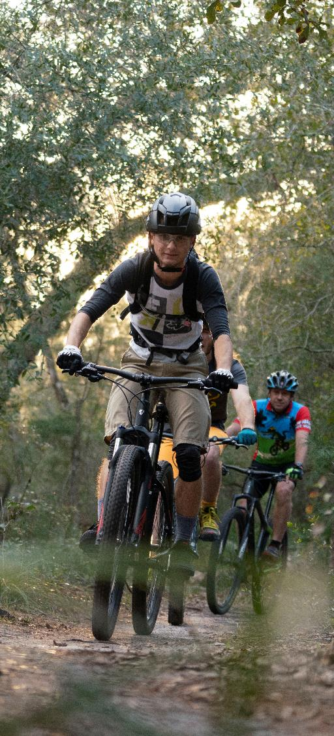
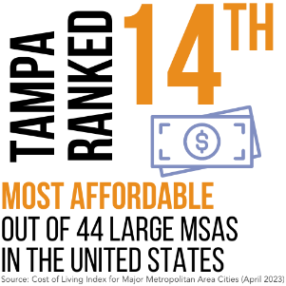
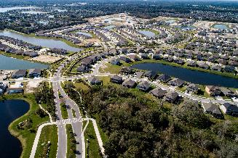
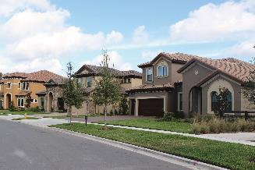
PASCO COUNTY PROFILE
HOUSING
RECREATION
Award winning
master- planned
communities
offering a variety of housing options.
394
24
21,000
Miles of Hiking and Biking Trails
Miles of Coastline to Explore
Acres of Natural Parks and Preserves
$335K
$1,524/mo
Median House Price (Redfin)
Average Apartment Rate (Apartment List)
AROUND THE BAY
45
45
60
60
Minute Drive to Downtown Tampa
Minute Drive to Clearwater Beach No. 1 Beach in America*
Minute Drive to Downtown St. Pete
Minute Drive to St. Pete Beach No. 5 Beach in the World**
EPPERSON
STARKEY RANCH
Source: *Tripadvisor, 2019, **Tripadvisor, 2021

Slide 4
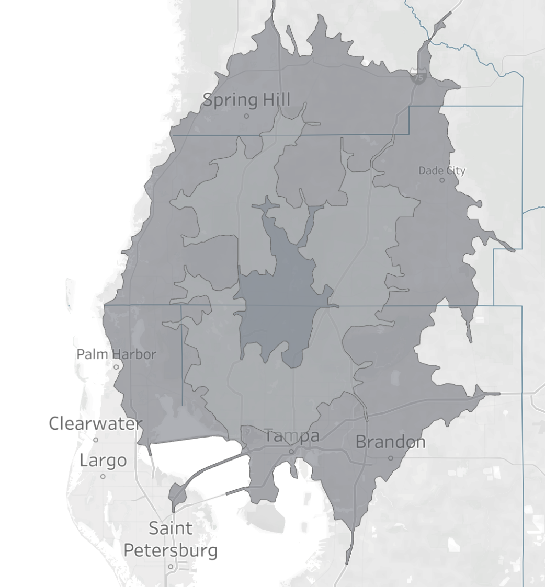
ACCESS & MOBILITY
Quick access to the Tampa Bay region’s assets such as Tampa International Airport, Port Tampa Bay, St. Pete International Airport, public and private universities and colleges, plenty of entertainment options including professional sports teams.
45-Minute Drive
A 30-minute commute from the center of the county gives you access to a labor pool of 1,711,710 workers that possess a wide array
of experience and skills.
30-Minute Drive
15-Minute Drive
St. Pete/Clearwater International Airport
Tampa International Airport
Port Tampa Bay
30-Minute Average Drive Time

Slide 5
FLORIDA TAX CLIMATE
0%
STATE PERSONAL INCOME
5.5%
CORPORATE INCOME TAXES ARE 5.5%, LESS A $50,000 EXEMPTION, AND S-CORPORATIONS ARE EXEMPT FROM COPRORATE INCOME TAX
4th
BEST TAX CLIMATE IN THE UNITED STATES

Slide 6
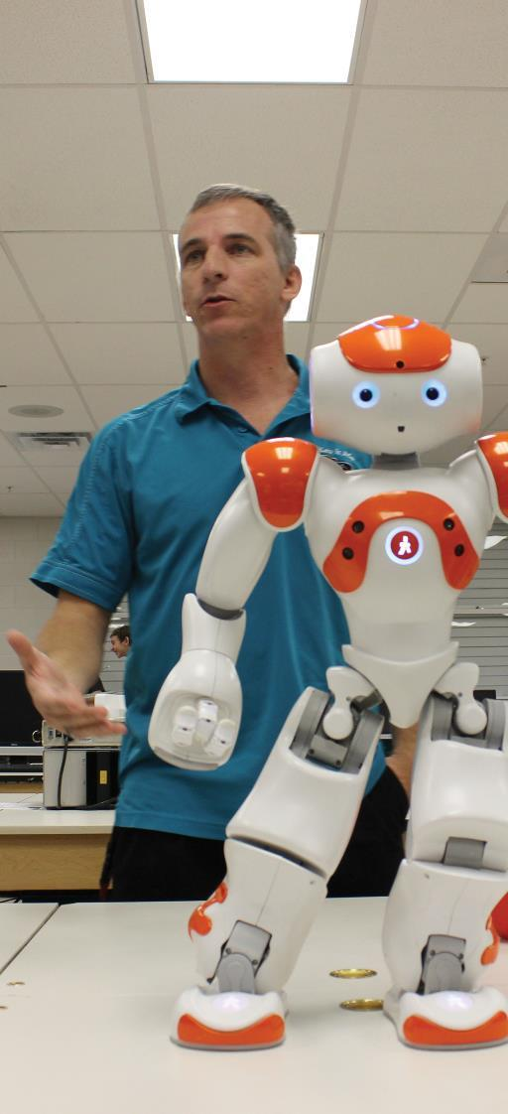
EDUCATION SYSTEM
Pasco County Schools received the designation as a System of Distinction* and serves 86,191 students daily.
Pasco’s A-rated schools include 40 pathways in Career and Technical Education programs through partnerships with local industry
Saint Leo University ranked #24 for Veterans in the United States**
University of South Florida ranks #45 among public universities in the nation***
AmSkills, a Pasco-based nonprofit, provides support for the manufacturing industry through workforce training and opportunities for youth, adults, veterans, and the economically disadvantaged.
Source: * Cognia, **Military Times Best for Vets: Colleges 2022 ***U.S. News and World Report

Slide 7
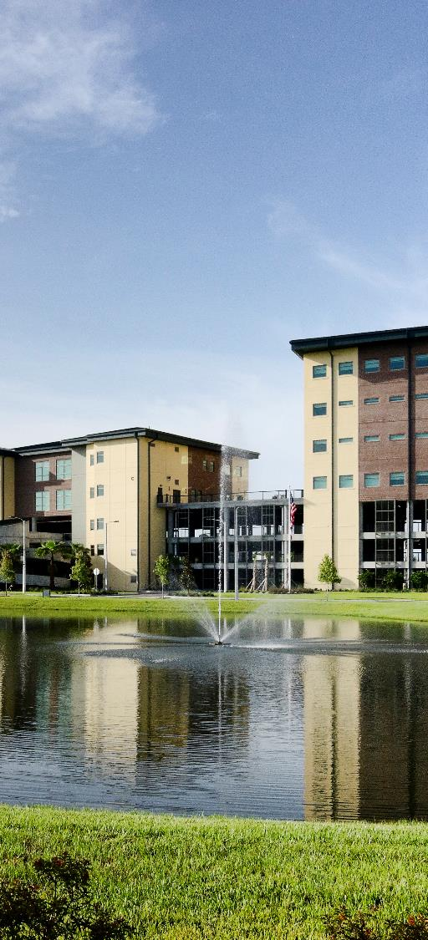
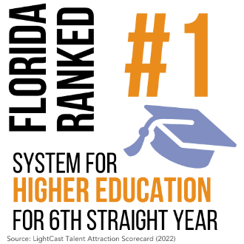
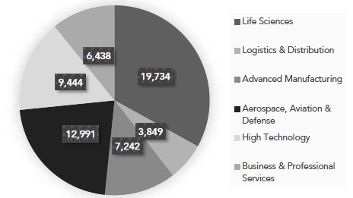
HIGHER EDUCATION
The Central Florida corridor is anchored by
three Preeminent State Research Institutions in addition to 125 other colleges, universities, tech and
trade schools.
Total awards earned for each target industry for the Tampa -St. Petersburg MSA during the 2021-2022 academic year.
529,892 Enrolled Students
61,145 4yr awards in 2021-22
^{Source: JobsEQ®}

Slide 8
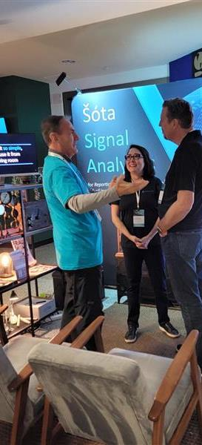
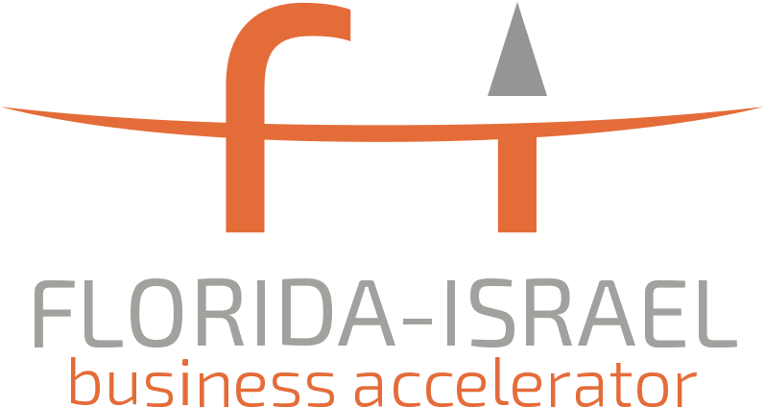
INNOVATION & START-UPS

Slide 9
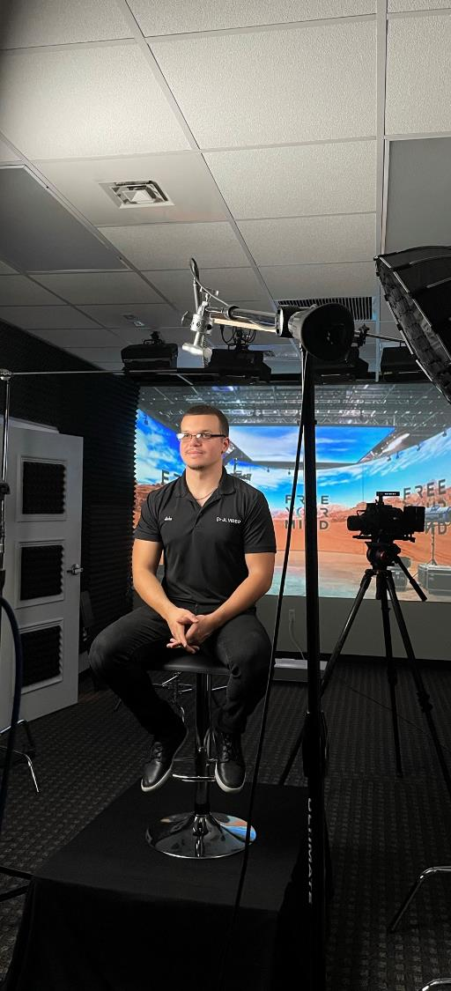
AVERAGE WORKFORCE WAGES
Advanced manufacturing
Pasco: $75,632
Florida: $90,747
US: $101,866
Life Sciences & Medical Technology
Pasco: $71,534
Florida: $100,548
US: $133,315
Business & Professional Services
Pasco: $59,987
Florida: $81,466
US: $123,061
High Technology
Pasco: $86,105
Florida: $110,989
US: $138,838
Source: JobsEQ

Slide 10
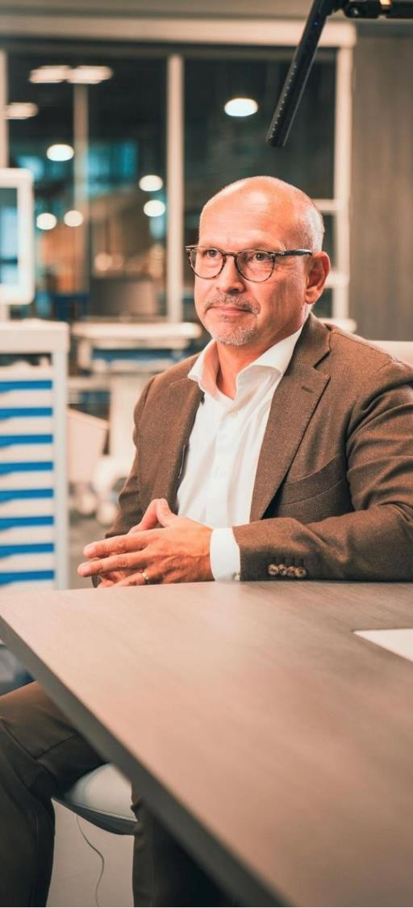
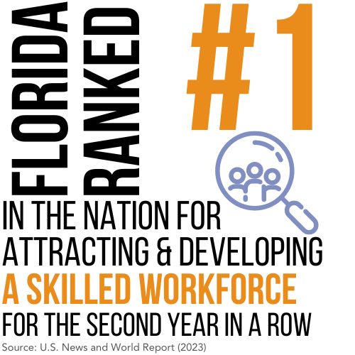
WORKFORCE BY TARGET INDUSTRY
MSA: 1,711,710
Pasco: 335,908
TOTAL LABOR POOL
Average number of workers within 30-minute drive:
Advanced manufacturing
38,133
Life Sciences & Medical Technology
18,393
Business & Professional Services
512,566
High Technology
84,927

Slide 11
Our workforceCONNECTpasco.com platform allows employers to find programs that produce talent that will thrive in their industries, and explore resources that can help their business stand out to top candidates. It also allows job seekers the opportunity to discover and explore various career pathways in a diverse economy of fast-growing industries.
HIRING
Whether you are searching for entry-level or experienced talent Pasco County has a robust workforce to meet all your needs. Explore our directory of training partners to find the perfect fit to recruit fresh graduates or download our guides on best practices when searching for more experienced talent.
LABOR MARKET DATA
Pasco is one of the fastest-growing counties in the United States and sometimes it is hard to find current data that reflects our growth. From average wages to drive time analyses and much more, we can help you make informed decisions when looking to grow your workforce.
INTERNSHIPS
Looking to create a learning opportunity for local students, or set up an apprenticeship program for your specialized manufacturing positions? We can help build your program from building your curriculum to writing your advertisement and connect you with a local partner to see your program through to success.
TRAINING GRANTS
Pasco County has a great selection of training providers that teach relevant and current workforce skills to your future employees. Best of all, your new and existing employees may be eligible for grants that will reimburse you for the cost of most training.
1
2
3
4

Slide 12
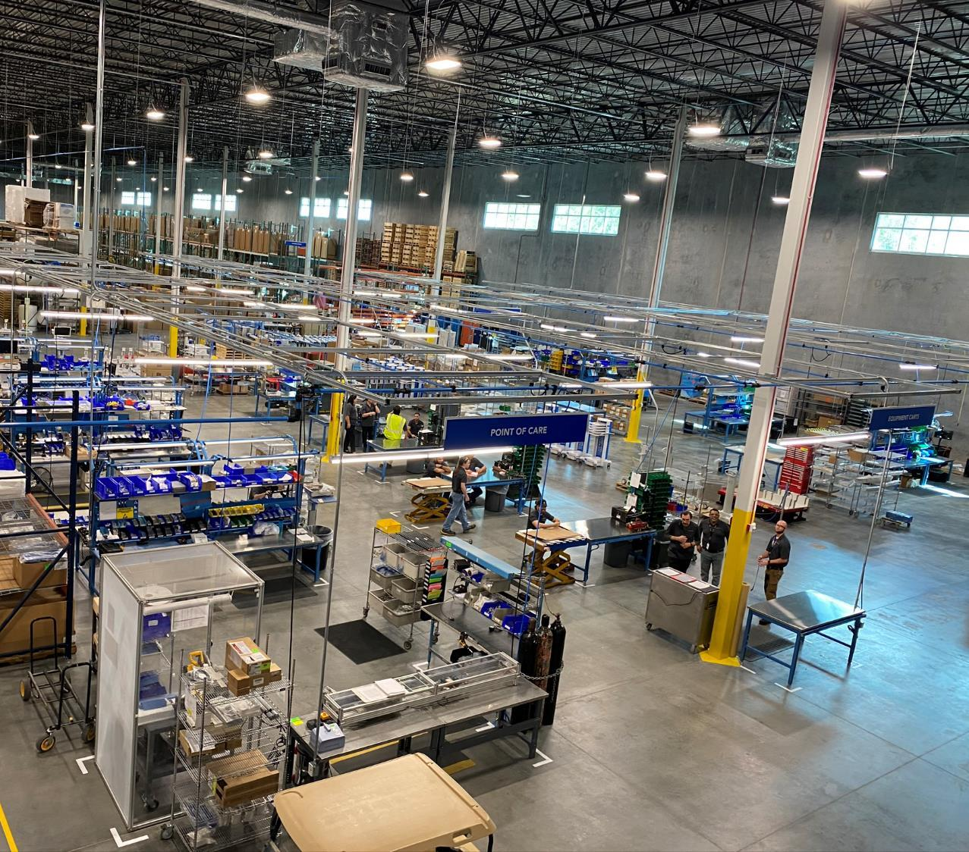
Touchpoint MEDICAL
LIFESCIENCES & MEDICAL TECHNOLOGY
SPEROS, FL

Slide 13
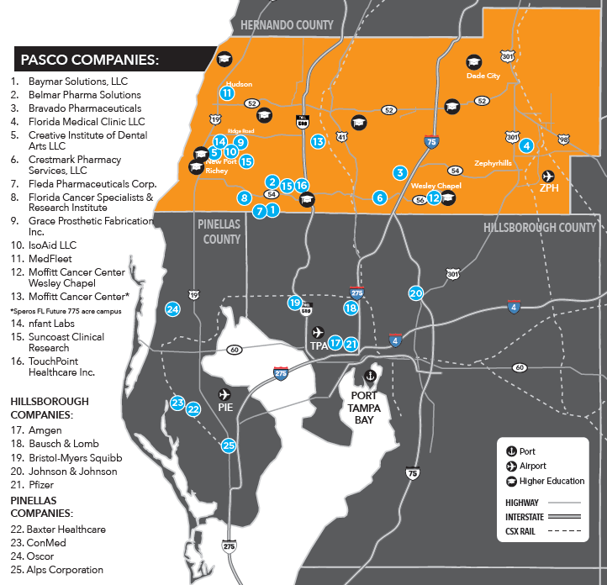
LIFESCIENCES & MEDICAL TECHNOLOGY

Slide 14
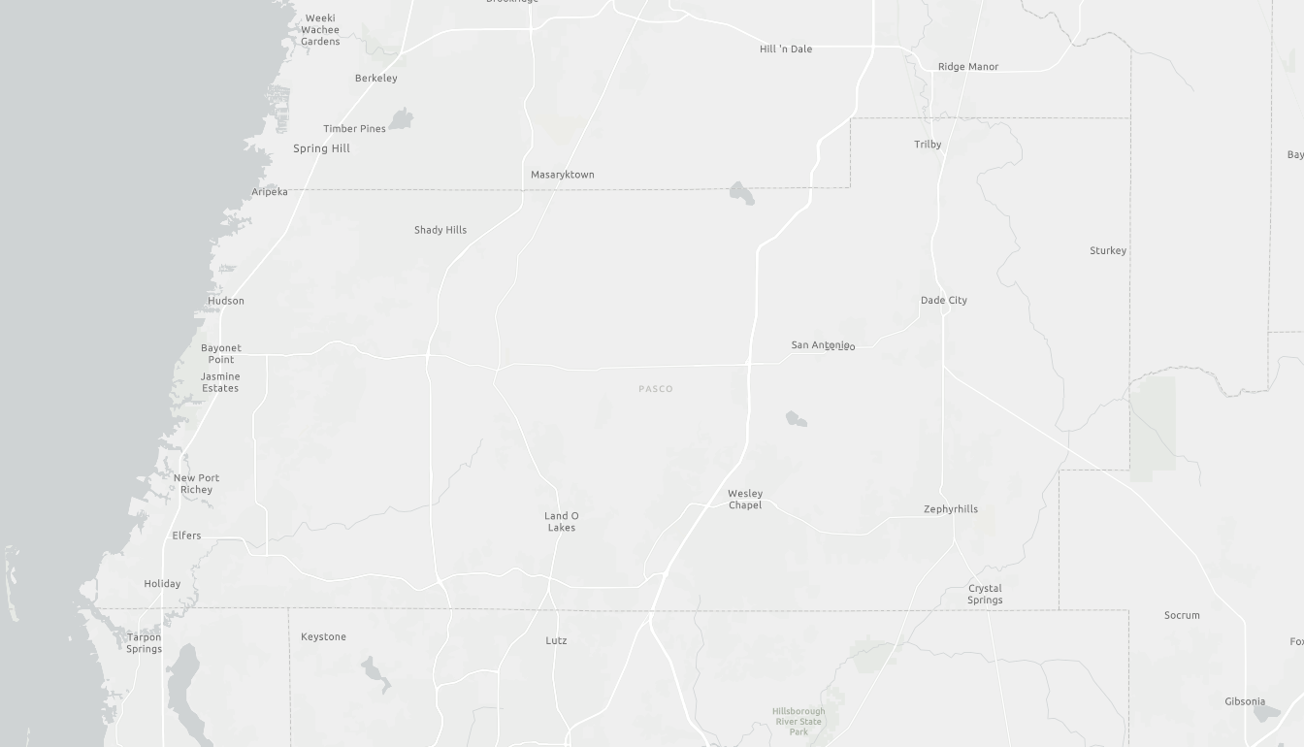
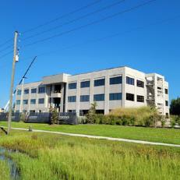
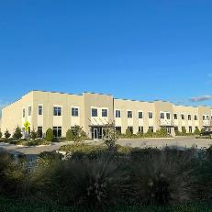
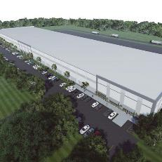
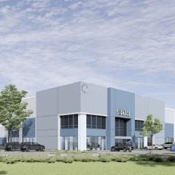
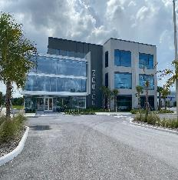
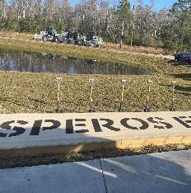
SPECULATIvE Buildings
54 CROSSINGS
ASTURIA
NORTH TAMPA BAY 75 BUSINESS CENTER
SUNLAKE BUSINESS CENTER
THE EDISON
MOFFITT CANCER CENTER, SPEROS FL

Slide 15
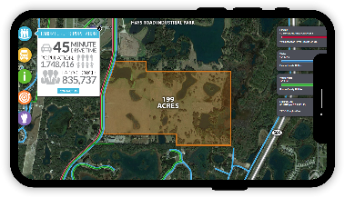
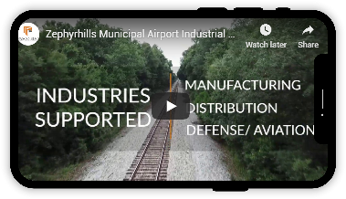
Pasco ready sites
The Ready Sites Program accesses, evaluates, and certifies large tracts of land to prepare properties for industrial development and create a portfolio of project-ready sites for targeted industries.
There are currently over 2,000 acres of land in the program. Each site features numerous digital tools for site selectors to utilize and tour the site.

Slide 16
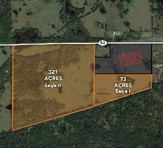
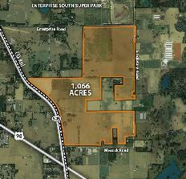
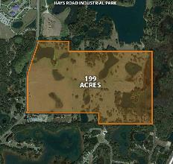
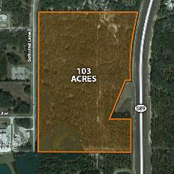
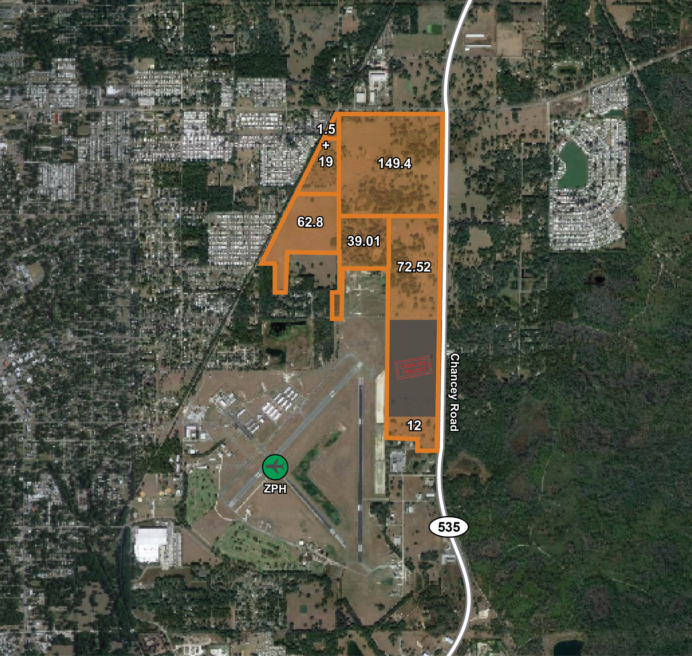
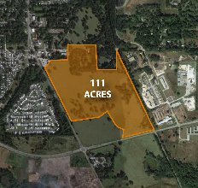
READY SITES PROGRAM
EAGLE I & II
INDUSTRIAL PARKS
ENTERPRISE SOUTH
SUPER PARK
HAYS ROAD
INDUSTRIAL PARK
SOFTWIND
INDUSTRIAL PARK
ZEPHYRHILLS AIRPORT INDUSTRIAL PARK
NORTH TAMPA BAY INDUSTRIAL PARK

Slide 17
SMARTLANDINGS PROGRAM
Services Offered:
Office space with flexible short-term leases
Connections and networking opportunities with the Tampa Bay business community
Assistance with the development of Florida and United States market intelligence using industry-tailored customer discovery methodology
Access to experts concerning import/export laws
Access to training and meeting rooms
Intellectual property protection assistance
Assistance with government documents and licenses
Assistance with meeting government regulations

Slide 18
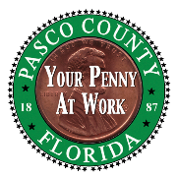
INCENTIVES
Penny for Pasco
$56 Million for Economic Development
Job Creation Incentive
$2,000-$5,000 per Job
Other Benefits for Companies:
Property Tax Refund
Training Grants
No Transportation Impact Fees for Office, Industrial and Hotels in the US19 and SR 54/56 Area
Lower Property and Communications Taxes
Expedited Permitting
State of Florida
Sales & Use Tax Exemptions on Manufacturing Equipment
Tax Exemption for R&D Equipment
Clean Energy Incentives
High Impact Performance Incentive
Capital Investment Tax Credit

Slide 19
How Pasco EDC can help
Real Estate Identification
Workforce Assistance
Incentive Identification
Demographic Data
Connecting with Stakeholders

Slide 20
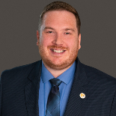
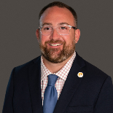
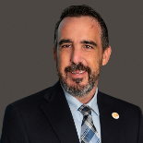
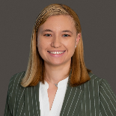
MEET OUR BUSINESS DEVELOPMENT TEAM
TURNER ARBOUR
BILL CRONIN
TURNER ARBOUR
BILL CRONIN
BILL CRONIN
PRESIDENT/CEO
SENIOR ECONOMIC
DEVELOPMENTMANAGER
MIKE BISHOP
DAN MITCHELL, EDP
SENIOR VICE PRESIDENT
SMARTstart PROGRAM DIRECTOR
TOM RYAN, CEcD
SARAH ALWAY
VICE PRESIDENT, BUSINESS DEVELOPMENT
Economic Development Coordinator

Slide 21
YOUR COMPANY HERE

Slide 22
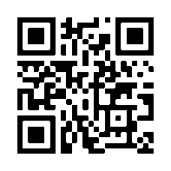
THANK YOU
Bill Cronin
President/CEO
Pasco EDC
bcronin@pascoedc.com
www.pascoedc.com

